Slide 1


National MSK Audit and Research Database

Slide 2
Meet the Team
A dedicated team responsible for managing the onboarding process -
Dr Roanna Burgess
Tamanda Smoke
Professor Kelvin Jordan
James Bailey
Alex Braybrooke
Please address any queries to fmhs.nationalmskaudit@keele.ac.uk

Slide 3
Onboarding Process
You are here
Stage 2
Stage 1
Stage 3
Stage 4
Stage 5
Registration of Services
Complete the Service Level Agreement form
https://forms.office.com/e/dL3RcLj7Cz
Governance sign off
Review the following documents -
DPIA
Data Sharing Agreement
Privacy Statement
Consent Form
Patient Information Leaflet
Sign off required from
Service Lead
R&D Lead
Data Manager/Informatics lead
Data Alignment
Embedding patient survey
Embedding FCP template (FCP services only)
Data Validation
Data Submission
Our expert team will validate the data and work with you to ensure accuracy and to address any questions or concerns
Agree a date for your first formal start and then initial data submission to the research database

Slide 4

Stage 2 - Governance
Privacy Statement
https://www.keele.ac.uk/media/k-web/k-research/nationalmskaudit/privacy-statement-v-1-06Apr2023.pdf
Participant Information Leaflet
https://www.keele.ac.uk/media/k-web/k-research/nationalmskaudit/participant-information-sheet-v-1-06Apr2023.pdf
Consent Form
consent-form-v-1-06Apr2023.pdf (keele.ac.uk)
DPIA
dpia-v-1-06Apr2023.pdf (keele.ac.uk)

Slide 5
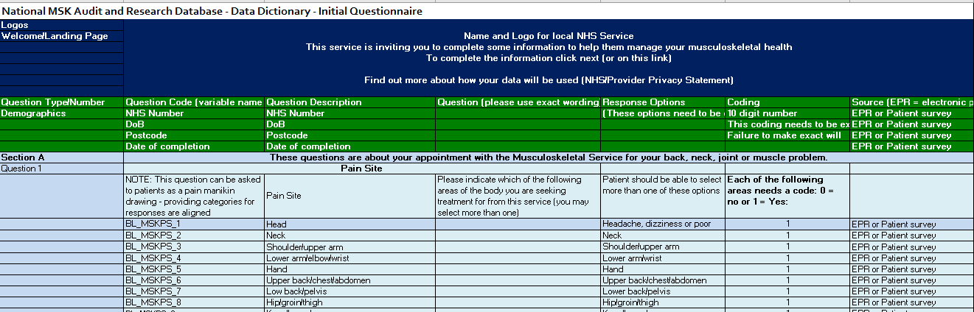
Stage 3
Data Dictionary available at www.keele.ac.uk/nationalmskaudit

Slide 6
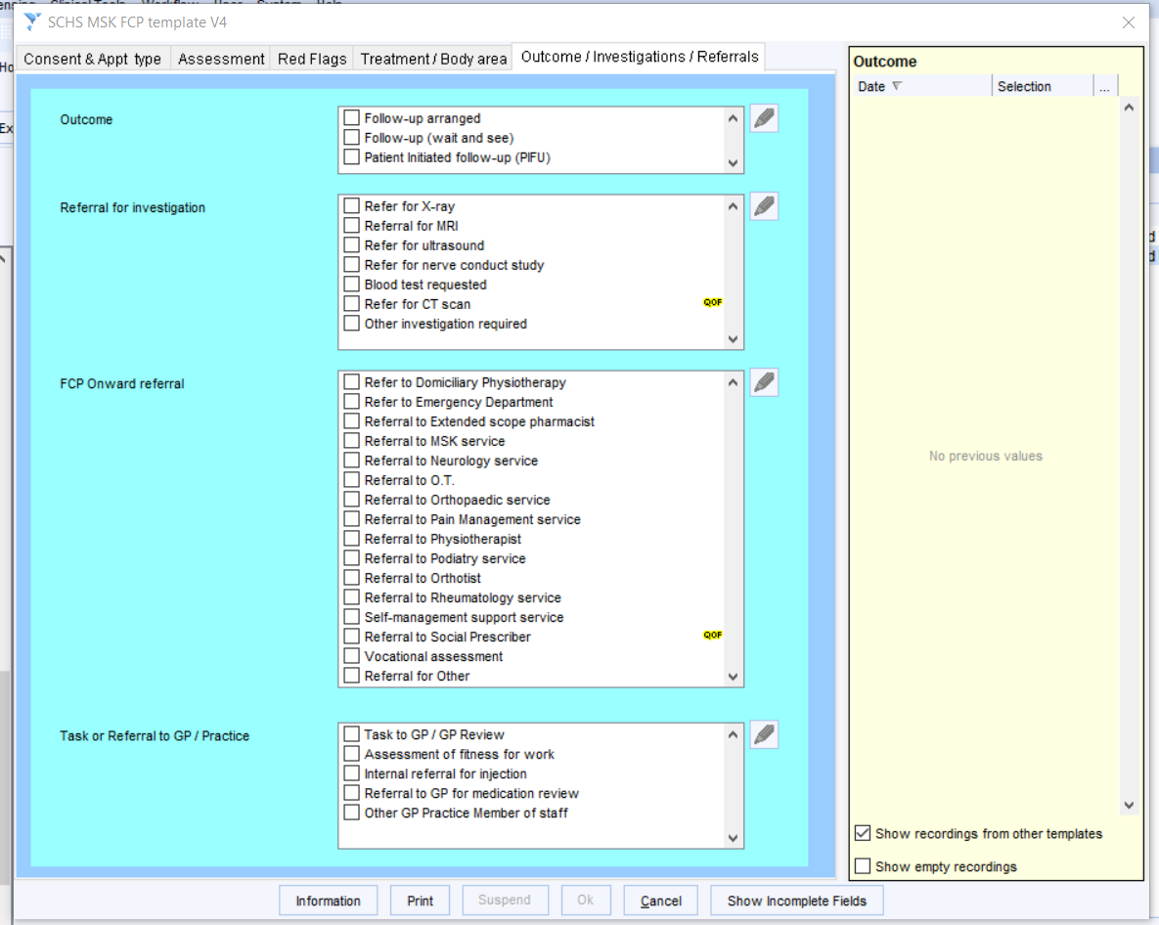
FCP Template
Clinical templates - Keele University

Slide 7
Stage 4 – Data Validation
Keele Team will provide five pre-filled questionnaires of dummy data to service
Service to enter dummy data into their data collection system plus an additional five pre-filled questionnaires of their own.
Service to upload dummy data to Keele SharePoint
Keele Data Manager to check coding/format of data submission to ensure meets data requirement and feedback
Service makes any necessary changes and re-checked as required
Proceed to Stage 5 – Data Submission

Slide 8

Stage 5 – Data Submission
When governance, data alignment & validation is complete, you will be able to progress to Stage 5, where dates will be agreed for your 6-monthly submission/data uploads to the Keele shared space.

Slide 9

You are Ready to Get Started!
Keep in touch, help us improve, and feedback through our Community of Practice

