Slide 1
Evidence Based Medicine: emotionally unstable personality disorder
10th October 2018
John Edwards
NIHR Academic Clinical Lecturer in Primary Care

Slide 2
Introduction
Approaches to information mastery
Asking an answerable clinical question
Examples of questions considered by the GP group
Getting an answer
Implementing in practice: emotionally unstable personality disorder
Resources

Slide 3
Examples of questions considered in the GP EBP group
How best to diagnose IFG/IGT
Risk of progression from IFG/IGT to diabetes
Use of high dose statins post ACS
Primary care management of nasal polyps
Thyroxine replacement risks (low TSH)

Slide 4
Information Mastery
Foraging: having a reliable system to alert one to new, important, relevant, valid information that requires one to change one’s practice.
Hot synching: purposefully checking and updating one’s personal mental map of knowledge and skills once or twice a year for each of the conditions one sees frequently (estimated at 30 to 40 in primary care).
Hunting: having a reliable system to find the best possible answer to a specific question and recognise it as such, quickly and efficiently.
National Prescribing Centre. Supporting adoption of evidence into practice. MeReC Bulletin 2011;22(02).

Slide 5
Foraging
Digests
NICE
BMJ/McMaster EvidenceUpdates
Cochrane Library or Cochrane Clinical Answers
TRIP
Journal alerts
BMJ,
Br J Psychiatry,
Evidence Based Mental Health,…

Slide 6
Hot synching
Update courses galore
Online (BMJ, etc)
Face to face (e.g. Brighton & Sussex)
‘No such thing as a free lunch…’

Slide 7
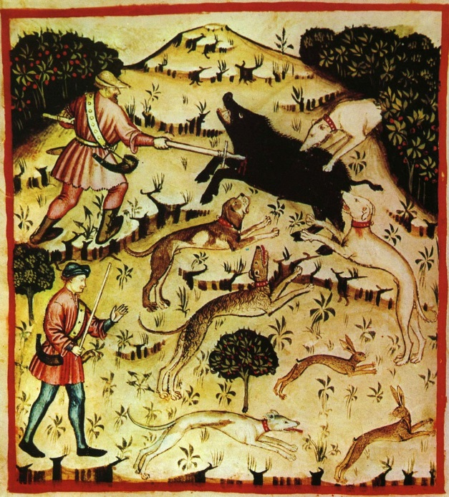
Hunting
The skill of finding evidence when required
Just in time vs. dedicated session
Evidence pyramid/table

Slide 8
SR
RCTs
Cohort study
Case control study, case series
Mechanism-based learning
OCEBM Levels of Evidence Working Group. The Oxford 2011 Levels of Evidence
2011. http://www.cebm.net/index.aspx?o=5653 .

Slide 9
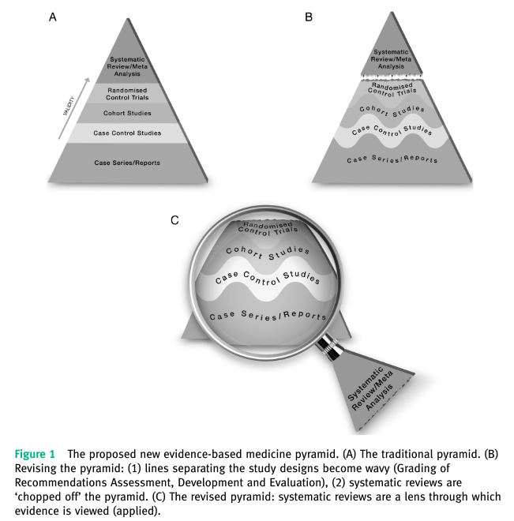
Murad MH, Asi N, Alsawas M, et al. New evidence pyramid. Evid Based Med 2016;21(4):125-7 doi: 10.1136/ebmed-2016-110401

Slide 10
High level sources
Cochrane Library
BMJ Best Health
BMJ Clinical Evidence
NICE Clinical Knowledge Summaries

Slide 11
5 stages to EBM
Ask a focused, answerable clinical question
Systematically retrieve the best evidence
Critically appraise evidence
Act (appropriately) on the evidence
Evaluate the decision making

Slide 12
Answering a focussed question
P opulation – how can I describe a group of patients similar to the one I am interested in?
I ntervention or E xposure – what is the main intervention (exposure) I am considering?
C omparator – do I want to compare the intervention to placebo or some other standard?
O outcome – what is/are the outcome(s) I am interested in? Benefits and/or harms?

Slide 13
Finding the answer…
Various methods
TRIP database
NHS Evidence search
PubMed

Slide 14
An example…
Does case management reduce the risk of admission for people with emotionally unstable personality disorder?

Slide 15
…as a structured question
P…
In patients with EuPD
I …
does case management
C …
compared with usual care
O …
reduce the risk of admission overall?...
(is this consistently diagnosed?)…
(is this consistently defined?)…
(what would this mean?)…
to mental health hospitals?...to acute general hospitals?

Slide 16
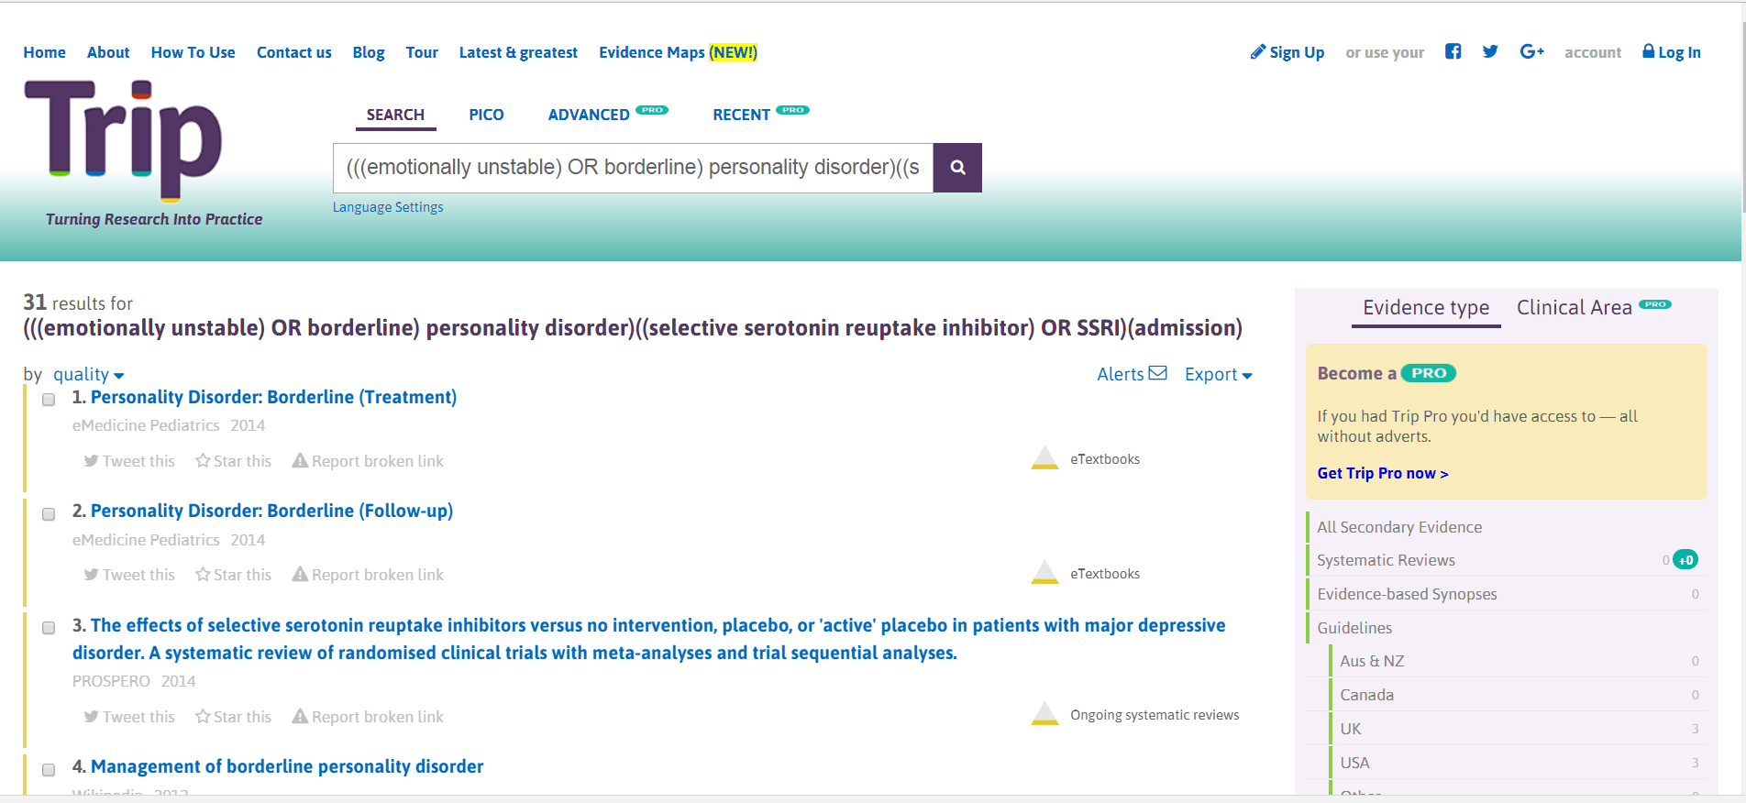
Plugged into a TRIP PICO search…

Slide 17
…or NHS Evidence…

Slide 18
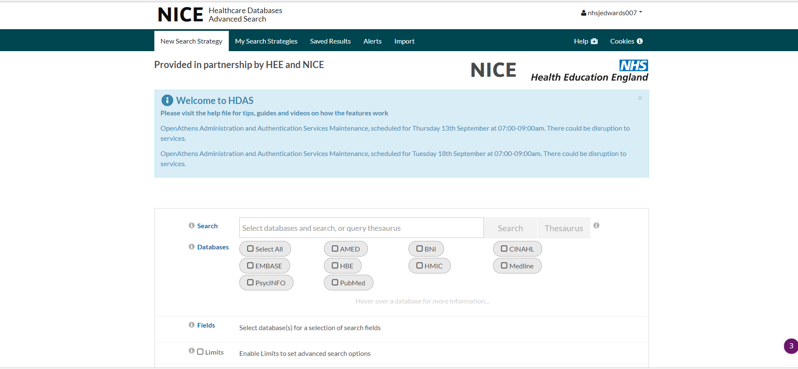
…or an NHS Evidence Advanced Search

Slide 19
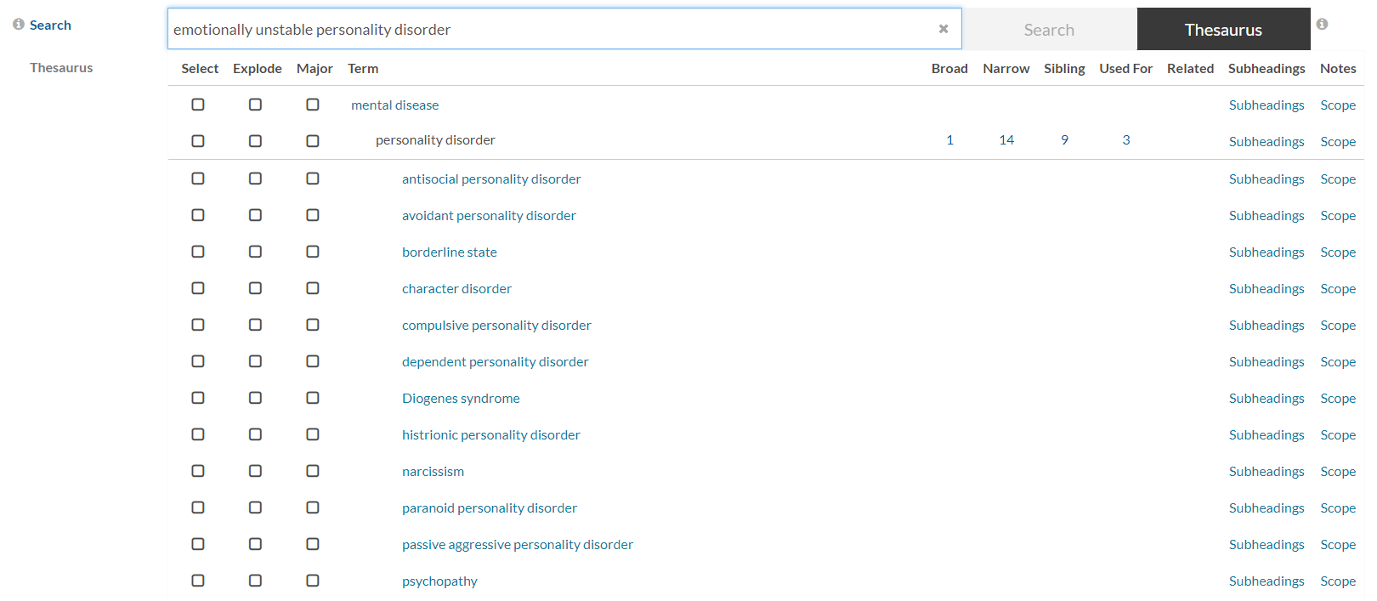
Building an advanced search

Slide 21
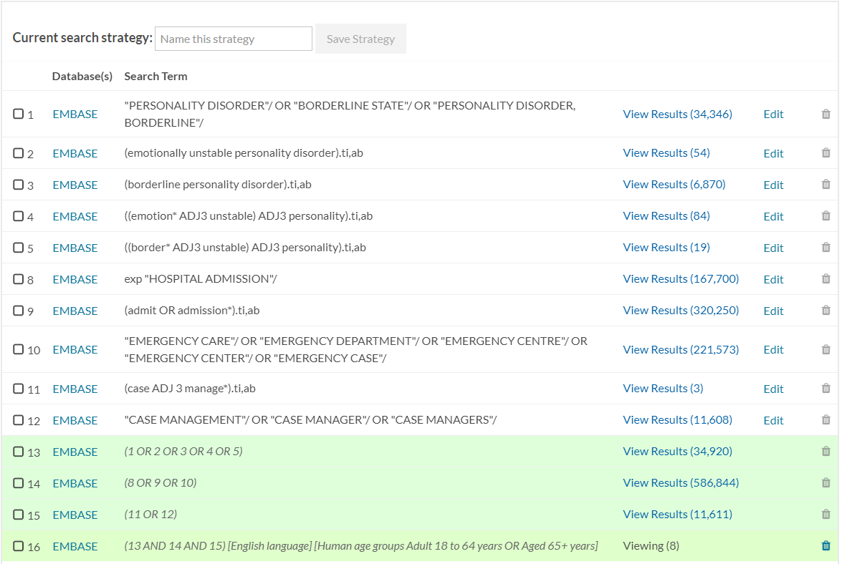
Output

Slide 22
Selected articles
Dialectical behavior therapy for high suicide risk in individuals with borderline personality disorder: A randomized clinical trial and component analysis
Psychosocial interventions for self‐harm in adults
Case Management may Reduce Emergency Department Frequent use in a Universal Health Coverage System: a Randomized Controlled Trial

Slide 23
Appraisal of the evidence - validity
RAMMbo
Representativeness – trial population
Allocation – randomisation
Maintenance of allocation – equal treatment
Measurement of outcomes – blind subjective, or objective
Analysis
GATE frame

Slide 24
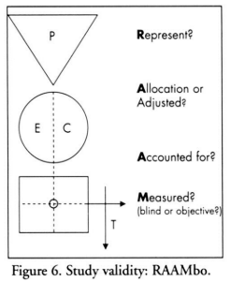
GATE Frame
Jackson R, Ameratunga S, Broad J, et al. The GATE frame: critical appraisal with pictures. ACP journal club 2006;144(2):A8-11

Slide 25
Analysis – not all p values
Large study
Observed effect = True effect + Bias (Confounding) + Random error
Good design
Effective randomisation
Statistical adjustment

Slide 26
Estimates of the truth
Random error less
Random error greater
Unbiased
Biased

Slide 27
How to make sense of the information
Depend on pre-appraisal, vs. do your own
Kitemarked information (Cochrane, NICE)
How good is someone else’s appraisal?
Don’t forget harms
Don’t believe everything you read…

Slide 28
"Evidence based medicine is not “cookbook” medicine. Because it requires a bottom up approach that integrates the best external evidence with individual clinical expertise and patients' choice, it cannot result in slavish, cookbook approaches to individual patient care. External clinical evidence can inform, but can never replace, individual clinical expertise, and it is this expertise that decides whether the external evidence applies to the individual patient at all and, if so, how it should be integrated into a clinical decision."
Sackett DL et al. BMJ 1996;312:71

Slide 29
Campaign for Real EBM
https://podcasts.ox.ac.uk/campaign-real-ebm-evidence-based-medicine
Ethical care of the patient
Individualised evidence
Expert judgment not mechanistic rule following
Shared decision making
Builds on a strong partnership
Applied at a community level for public health

Slide 30
Actions to deliver real EBM
Demanding patients
Clinical training to hone judgments, shared decision making
Secondary evidence generators, funders and publishers to be careful…
Interdisciplinarity
https://www.bmj.com/content/348/bmj.g3725

Slide 31
Resources
BMJ How to Read a Paper http://www.bmj.com/about-bmj/resources-readers/publications/how-read-paper
Oxford Centre for Evidence Based Medicine www.cebm.net [loads of useful resources online]
Critical Appraisal Skills Programme http://www.casp-uk.net
Health Library http://www.keele.ac.uk/healthlibrary/

Slide 32
Next steps
Any appetite for a systematic review…?
Agree the clinical question
Develop a search strategy
Register the review
Title sifting, then abstracts, then full text (x2)
Final inclusion
Data extraction (x2)
Evidence synthesis

Slide 33
Acknowledgments

Slide 34
Research Institute for Primary Care and Health Sciences David Wetherall Building Keele University Newcaslte-under-Lyme ST5 5BG
Tel: 01782 733905 Fax: 01782 734719 www.keele.ac.uk/pchs

