Slide 1

Facilitator notes*
Use the videos as part of the careLeD tool or as a standalone activity in groups or individual one-to-one sessions.
Stop the video as needed to highlight key points.
Encourage individuals to guess the correct answer at the prompt.
Talk about occasions where individuals might need to call urgent or emergency care services.
Explain the role of the professionals who answer the calls.
Talk about how Olivia gets extra support when she tells the healthcare adviser that she has a learning disability.
*not part of the presentation

Slide 2
Videos
careled.info

Slide 3
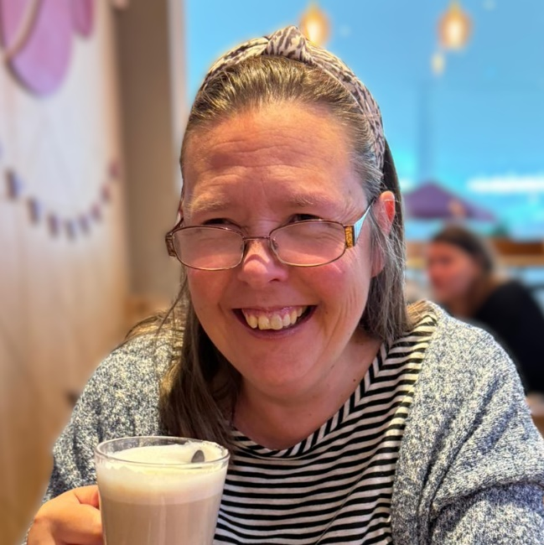
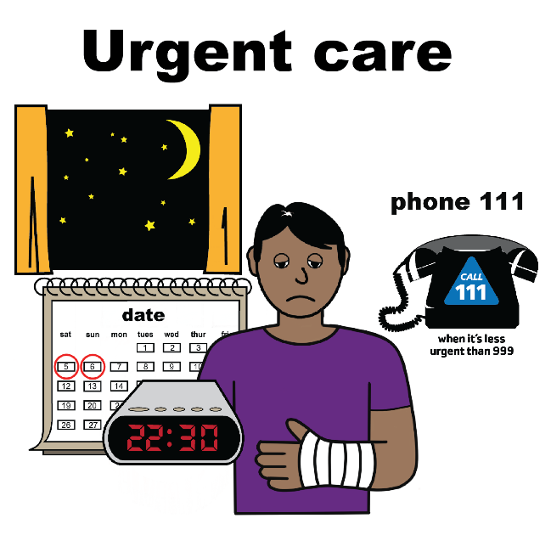
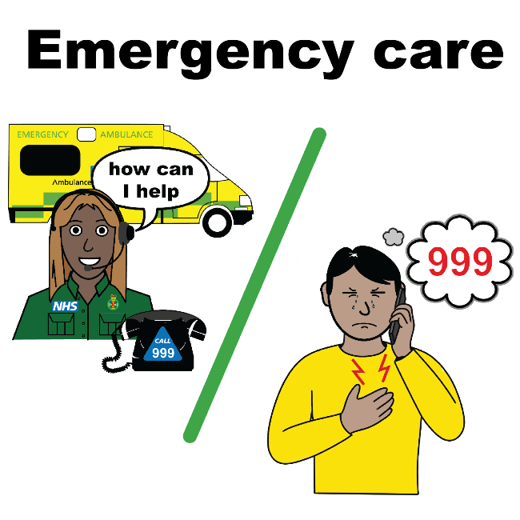

Meet Olivia
This is Olivia.
In the videos Olivia tells us about when she was feeling unwell.
Olivia tells us about getting help from 111 and 999.
All ‘easy on the i’ images copyright © LYPFT

