Slide 1

careLeD tool
Facilitator guidance
careled.info

Slide 2
Facilitator notes
careLeD is a tool to help people with a learning disability access urgent and emergency health care.
Use the careLeD tool and activities in groups or individual one-to-one sessions.
The careLeD tool is made up of two pdf’s ‘helping yourself’ and ‘helping others’ plus supporting activities.
You can use the careLeD tool online or offline.
Note that you can skip the interactive videos and just go through the Olivia scenarios (or use both to reinforce the message).

Slide 3
Facilitator notes
The careLeD tool and activities are not a substitute for accessing care. Please encourage individuals to ask for help, especially if they are unsure.
The careLeD activities are designed to facilitate shared learning and understanding in group settings. It may be appropriate to remind individuals that the group sessions are a safe space, but that any personal information should not be shared beyond the group.
Some careLeD activities (such as the social story) may involve recording personal details that individuals may not wish to share in a group setting.
  Remind group members that they don’t have to share if they don’t want to.
  Remind group members to respect individual confidentiality.

Slide 4
Facilitator notes
The language used in the careLeD tool intentionally reflects everyday usage across the UK and may not align with current preferred terms (e.g. seizure/fit).
Images in the careLeD tool may not represent the severity of an injury (particularly in the emergency care section) - this may be an additional point for discussion.
careLeD has been designed as an educational tool to be used in conjunction with existing tools (e.g. hospital passports or health profiles) not as a replacement. We recognise that not everyone uses or has access to some or all of the existing tools.

Slide 5
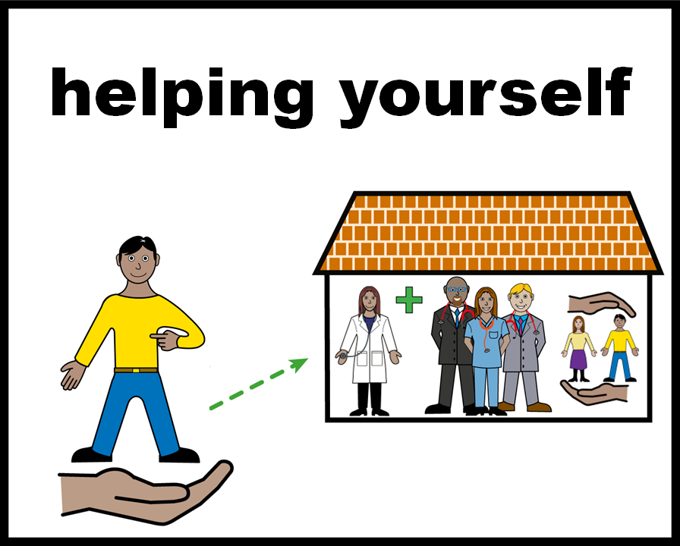

careLeD: 1
All ‘easy on the i’ images copyright © LYPFT

Slide 6
careLeD: 1
What is an urgent health need, when should you call 111?
What is an emergency health need, when should you call 999?
Scenarios and videos
What to do
Asking for extra help
Activities (with facilitator guidance)
  Making an emergency bag
  Regional variations
  Local services
  Videos
Resources

Slide 7
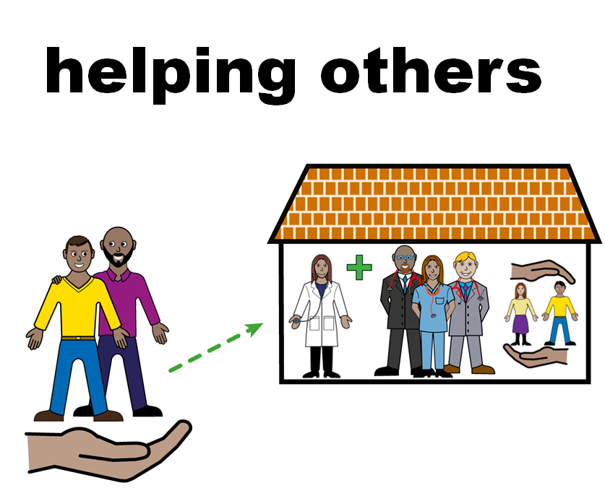
careLeD: 2

Slide 8
careLeD: 2
What is an urgent health need, when should you call 111 for someone else?
What is an emergency health need, when should you call 999 for someone else??
Scenarios
What to do if someone else has an urgent or emergency health need
Asking for extra help
Activities (with facilitator guidance)
  Create your social story
  Getting a hospital passport or health profile
  Discussion
  Print your certificate
Resources

Slide 9

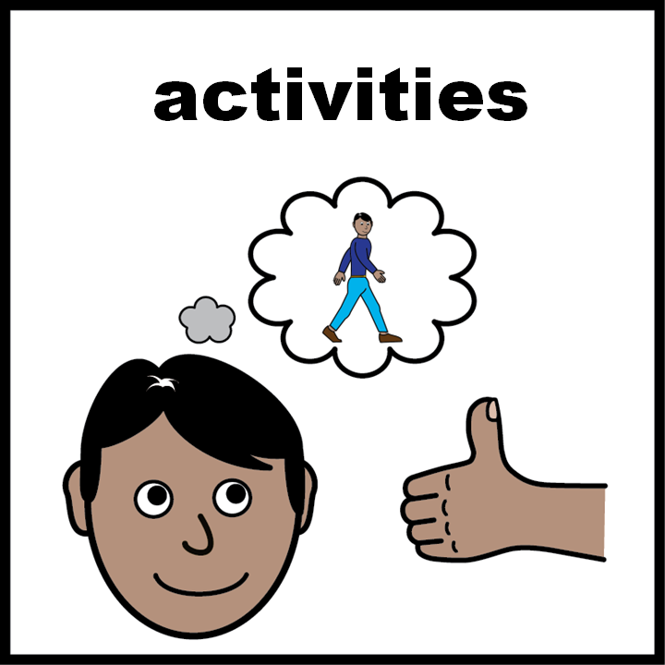
careLeD: Activities
The careLeD activities are interactive and have been designed to support the tool.
The facilitator notes are a hidden slide and are not part of the presentation. They are indicated by:
Some activities may require a printer. They are indicated by:
Some activities are active (e.g. may require visits or drawing and painting). They are indicated by:
Most activities require some minimal preparation in advance.

Slide 10
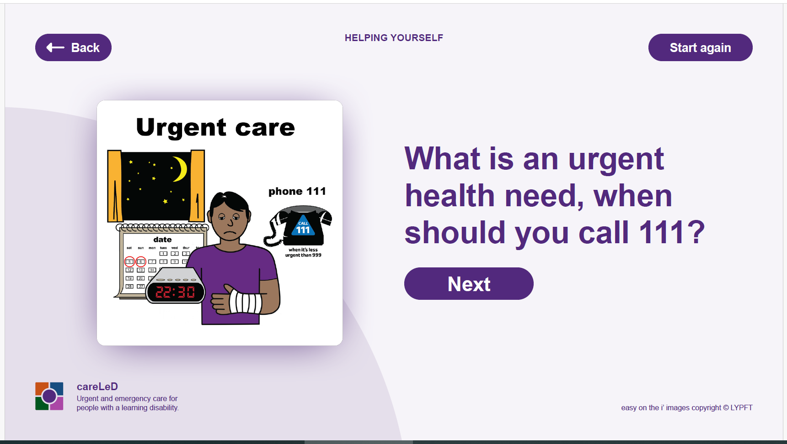
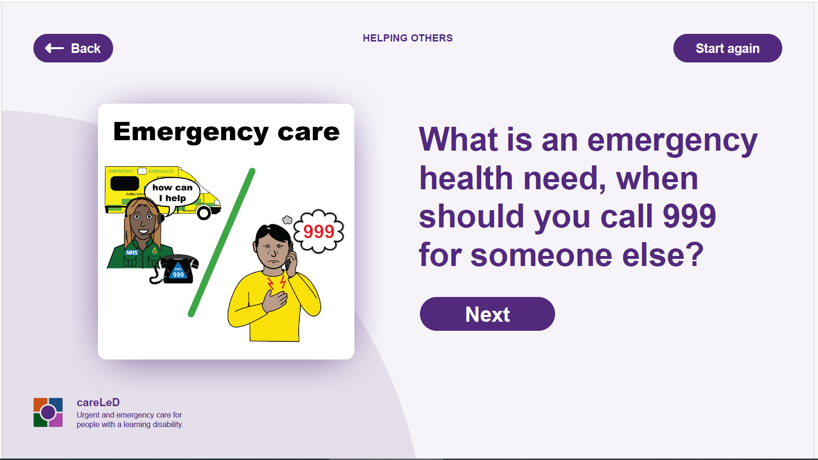
careLeD: Quick links
Click on the links to get access
careLeD 1: Helping Yourself
careLeD 2: Helping Others
Resources
Getting a hospital passport or health profile
Create your social story & social story example
Making an emergency bag
Videos
Regional variations
Local services
Discussion
Print your certificate

