Slide 1

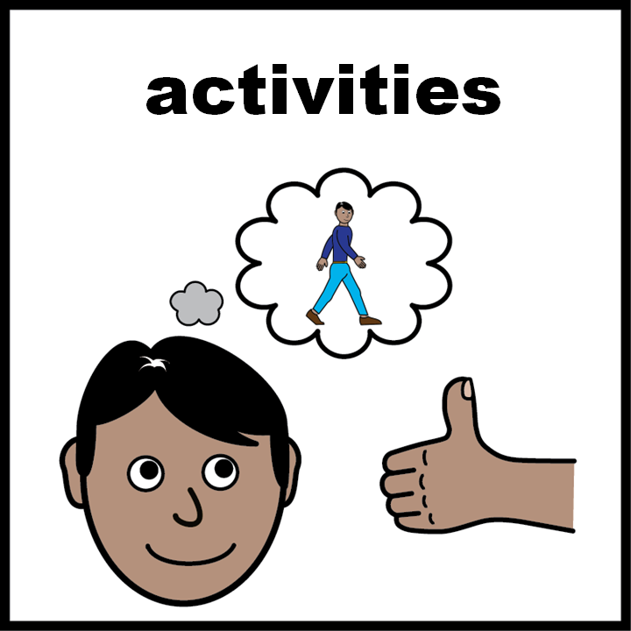
Facilitator notes*
Use this slide set in group sessions or one-to-one.
When preparing to run a session please check the slides and activities in advance and download/prepare any additional materials that might be needed.
This activity is to help individuals to familiarise themselves with who they need to contact to access urgent care depending on where they currently live.
It will help individuals understand where they can find localised urgent health and care information.
It might be helpful for when individuals need urgent care in the evening or night-time or at the weekend, when their usual care route such as their GP or dentist is closed.
You might want to discuss how it could be different when on holiday, a visit, or after moving house.
*not part of the presentation

Slide 2
Regional Variation
careled.info

Slide 3


Scotland
NHS 24 111: The 111 service provides urgent telephone support when you need help when your doctors or dentist is closed.
NHS Inform: A website from NHS 24 that offers health and care information and details of Scotland’s health and care services https://www.nhsinform.scot/
Breathing Space: Is a free and confidential phone service for anyone in Scotland over the age of 16 feeling low, depressed or anxious.
All ‘easy on the i’ images copyright © LYPFT

Slide 4

Northern Ireland
NHS 111 Northern Ireland: The 111 service provides urgent telephone support when you need help when your doctors or dentist is closed.
nidirect: Offers advice about illnesses and conditions and details of Northern Ireland’s health services https://www.nidirect.gov.uk/campaigns/illnesses-and-conditions
nidirect: Offers mental health support information in Northern Ireland https://www.nidirect.gov.uk/articles/mental-health-support

Slide 5
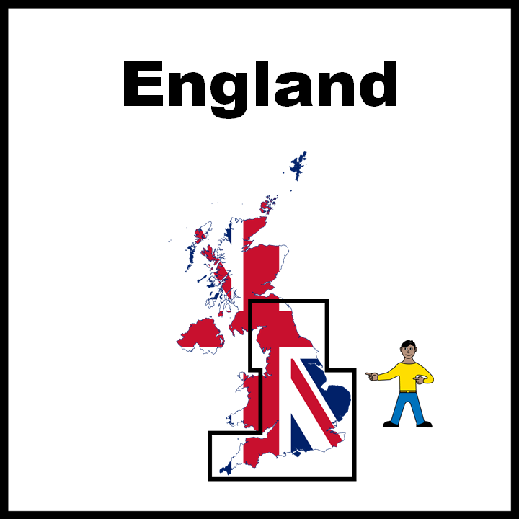
England
NHS 111: The 111 service provides urgent telephone support when you need help when your doctors or dentist is closed.
NHS 111 online: A website from NHS 111 that offers health and care information and details of England’s health and care services https://111.nhs.uk/
Mental Health NHS 111: Mental Health NHS 111 (Option 2) is available 24 hours a day, 7 days a week for people who are in need urgent support for their mental health.

Slide 6

Wales
NHS 111 Wales: The 111 service provides urgent telephone support when you need help when your doctors or dentist is closed.
NHS 111 Wales: Is a website from NHS 111 (Wales) that offers health and care information and details of Wales’s health and care services https://111.wales.nhs.uk/outofhoursservices/
Mental Health NHS 111: Mental Health NHS 111 (Option 2) is available 24 hours a day, 7 days a week for people who are in need urgent support for their mental health.

Slide 7

Cymru
GIG 111 Cymru: Mae'r gwasanaeth 111 yn darparu cymorth frys dros y ffôn pan fydd angen help arnoch pan fo’ch meddyg neu ddeintydd ar gau.
GIG 111 Cymru: Sy'n cynnig gwybodaeth am iechyd a gofal a manylion am wasanaethau iechyd a gofal Cymru https://111.wales.nhs.uk/Encyclopaedia/g/article/gwasanaethytuallanioriau
Iechyd Meddwl GIG 111 Cymru: Mae Iechyd Meddwl GIG 111 (Dewis 2) ar gael 24 awr y dydd, 7 diwrnod yr wythnos ar gyfer pobl sydd angen cymorth brys ar gyfer eu iechyd meddwl.

Slide 8
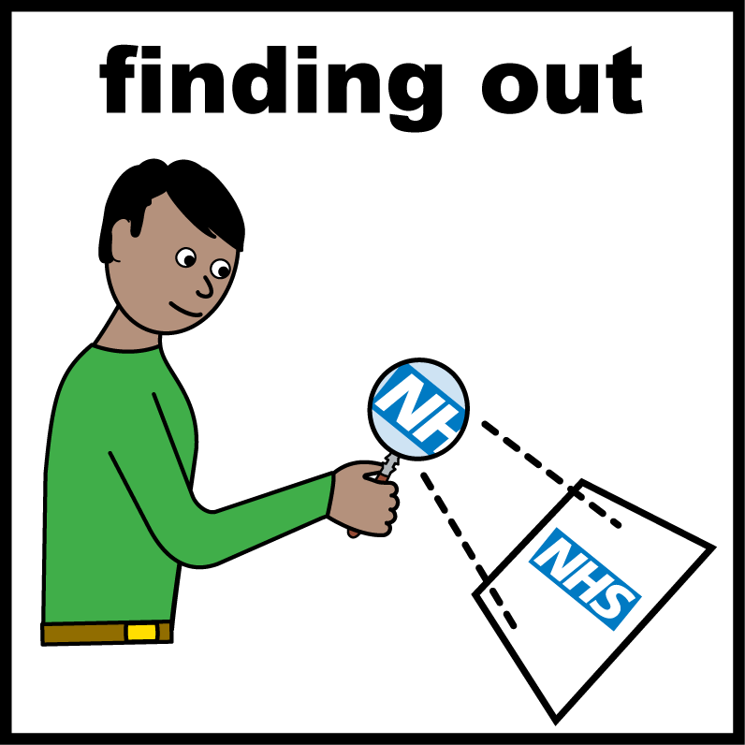
Activity
Find out who you need to phone if you need to access urgent care.
  At night-time.
  At the weekend when your doctors is closed and you are too ill to wait until your doctors is open.
Find out where else you can get health and care information.

Slide 9
Gweithgaredd
Dewch o hyd i bwy rydych angen ffeilio yn Nghymru os oes angen i chi gael mynediad i ofal brys.
  Ar noson.
  Ar y penwythnos pan fydd eich Meddyg wedi cau ac rydych chi'n rhy glefyd i aros tan fod eich Meddyg ar agor.
Ac rydych chi'n rhy glefyd i aros tan fod eich Meddyg ar agor.

