Slide 1

RCN Foundation
Learning Disability
Nursing Programme
Inclusive Health - enhancing the lives of individuals with learning disabilities
Deepa Korea
July 2025

Slide 2


About the RCN Foundation
We are a charity that helps all nurses, midwives and healthcare support workers
You do not need to be a member of the RCN trade union to get support from us
We want to make nursing and midwifery better to help people stay healthy
We get our money from donations and investments from the public and organisations
The Chair of our Board of Trustees is Professor Dame Jane Cummings

Slide 3

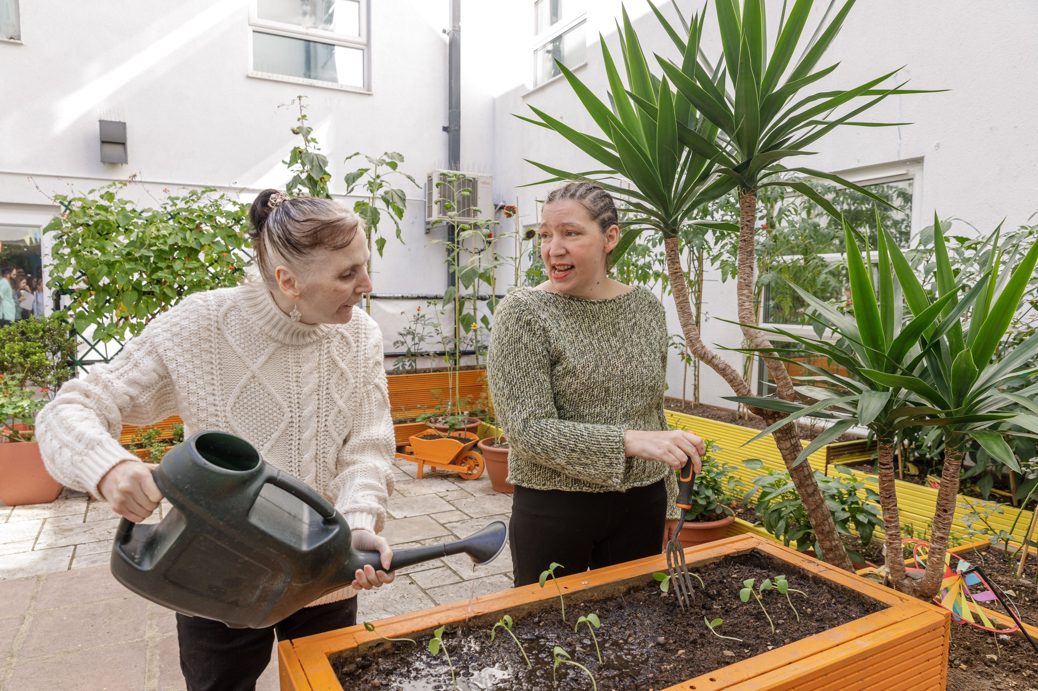
RCN Foundation Learning Disability Nursing Programme
The programme will last four years
The programme will cost £300,000
There will be nine research studies in the programme
We will be funding nurses in social care to become Advanced Practitioners, meaning they have high level skills

Slide 4
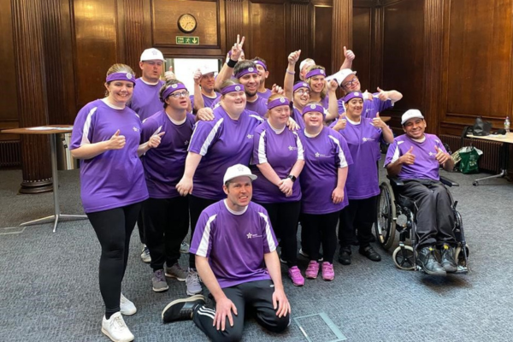
Aim of the programme
The aim of the programme is to help Registered Nurses Learning Disability (RNLD) improve health and quality of life for people with learning disabilities

Slide 5
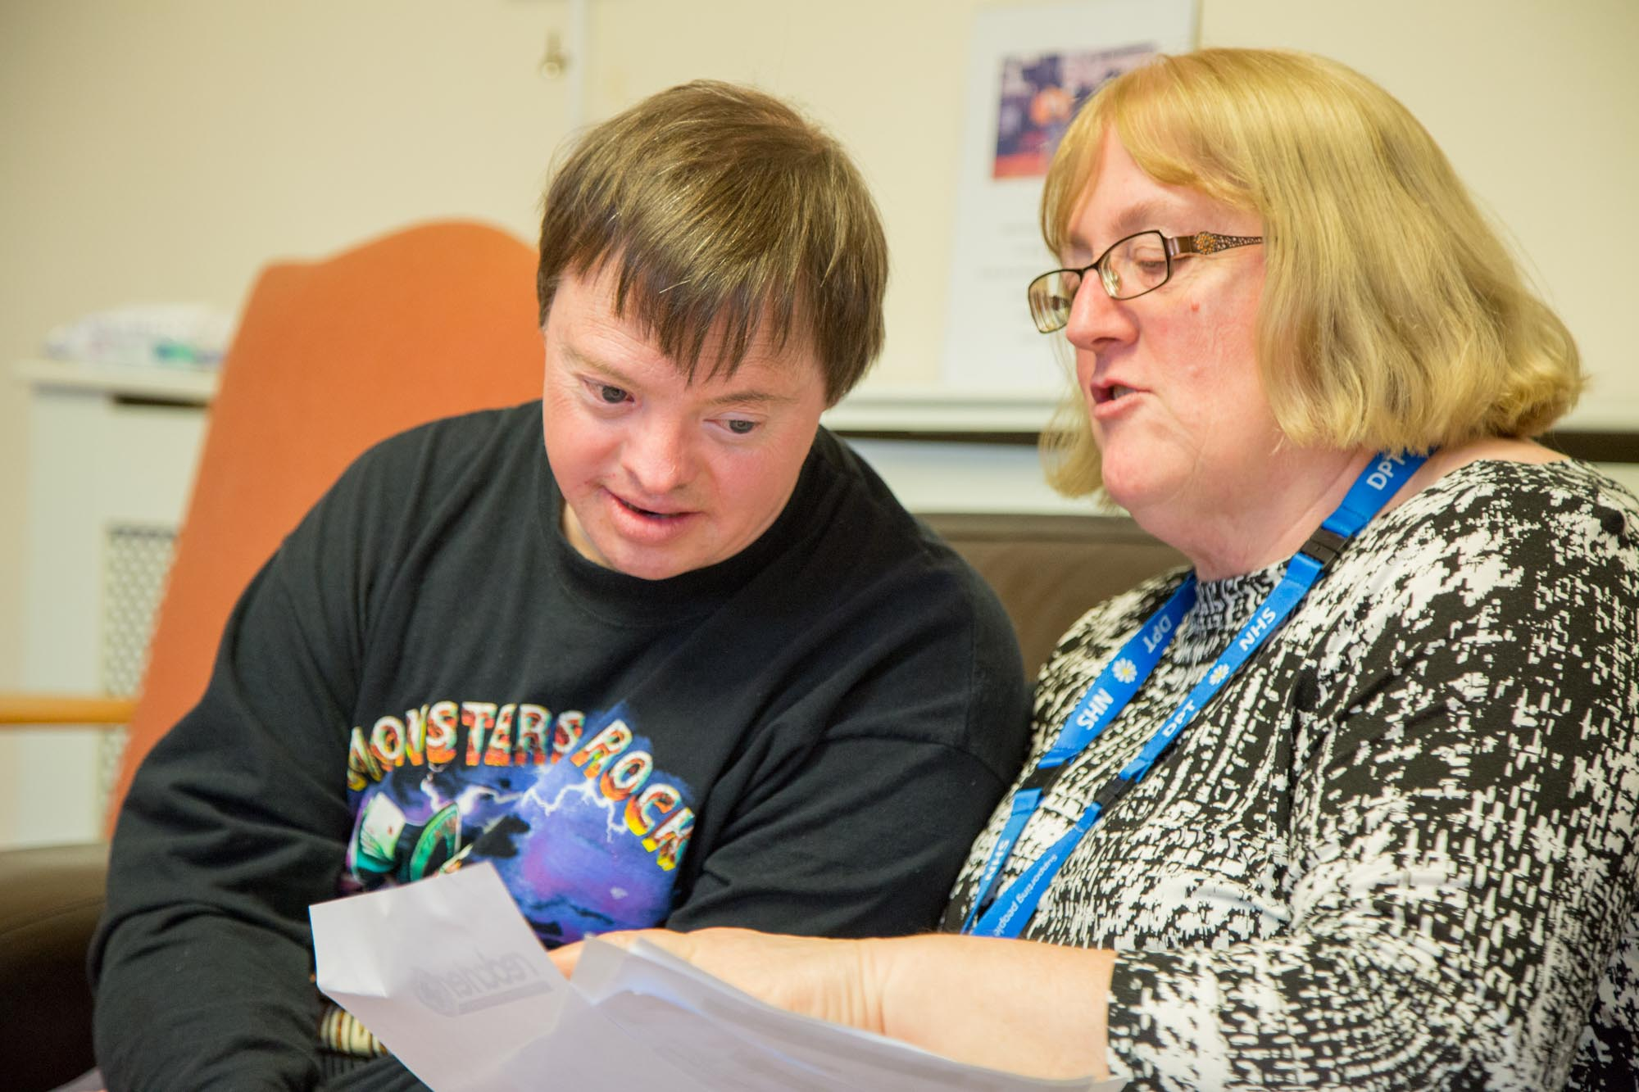
Programme objectives
The programme will:
  Build the evidence for learning disability nursing and midwifery, so we can reduce health inequalities and prevent early deaths for people with learning disabilities in the UK
  Improve the knowledge and skills of nurses and midwives who care for people with learning disabilities through education

Slide 6








Research were have funded

Slide 7

RCN Foundation and Keele University Urgent Care Access Now (UCAN) project
Learning disability nurses working for the ambulance service, NHS 111 and NHS24 said that people with a learning disability experience difficulties accessing urgent and emergency care
The RCN Foundation gave money to Keele University to help improve people with a learning disability access urgent and emergency care
They created the careLeD tool which has interactive and educational resources to help those with a learning disability more easily access urgent and emergency care

Slide 8
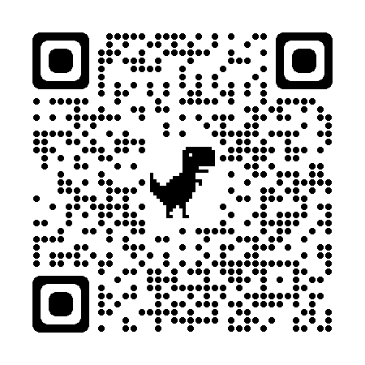
To learn more about the RCN Foundation click the link or scan the picture with your phone
www.rcnfoundation.org.uk

