Slide 1

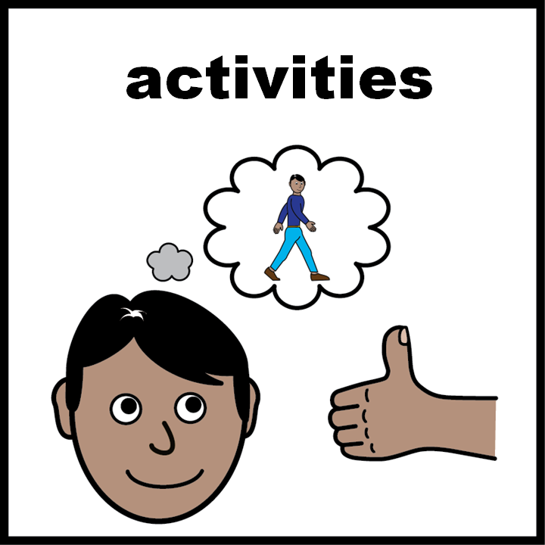
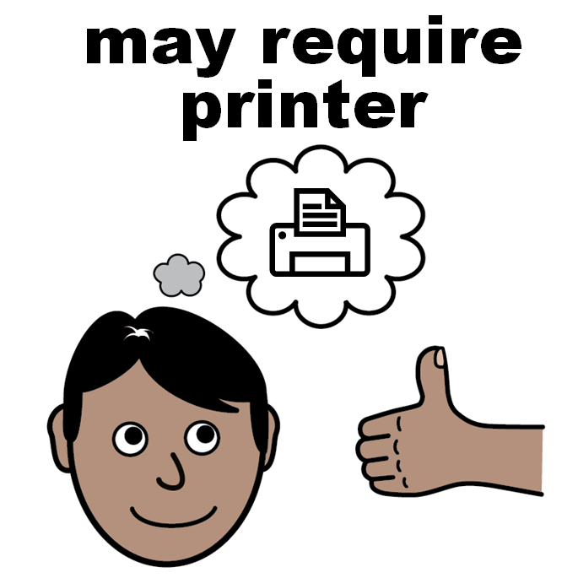
Facilitator notes*
Use this slide set in group sessions or one-to-one.
When preparing to run a session please check the slides and activities in advance and download/prepare any additional materials that might be needed.
Reach out to your local learning disability team in advance of the session to get local Hospital Passports/Health Profiles or download and print them (Slide 6).
Hospital Passport is the term used in England, Scotland and Northern Ireland.
In Wales, a similar document is called a Health Profile.
Encourage individuals to create and review their Hospital Passport or Health Profile regularly, especially after changes in medication or any new diagnosis.
Talk about occasions where individuals might want to share their Hospital Passport or Health Profile with professionals.
*not part of the presentation

Slide 2
Hospital Passports
&
Health Profiles
careled.info

Slide 3


A hospital passport or a health profile
Has information about you.
About your health.
Your learning disability.
How you communicate.
All ‘easy on the i’ images copyright © LYPFT

Slide 4

A hospital passport or a health profile
It helps you get care:
  At hospital
  At the doctors
Or if you see health and social care staff.

Slide 5
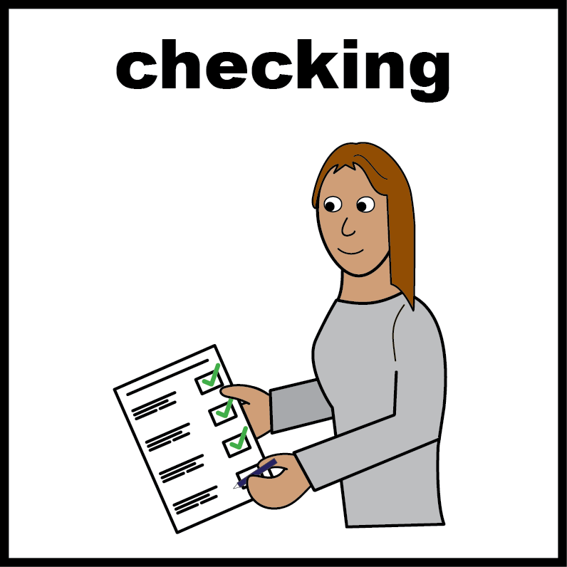
Activity
Do you have a hospital passport or a health profile?
Yes 
Look at your passport or profile.
Check the information is all correct.
Ask for help if you need support to do this.

Slide 6

Activity
Do you have a hospital passport or a health profile?
No 
Click here for England, Scotland and Northern Ireland or Click here for Wales or ask your local Learning Disability Team for one.
Complete or ask someone to help fill it in with you.

Slide 7

Your hospital passport or health profile
Write clearly.
Make sure information is correct.
Check the information is correct every six months or if there is a change to your health or medication.
Take to all your health appointments.
Let health and social care staff look at your passport or profile.

Slide 8

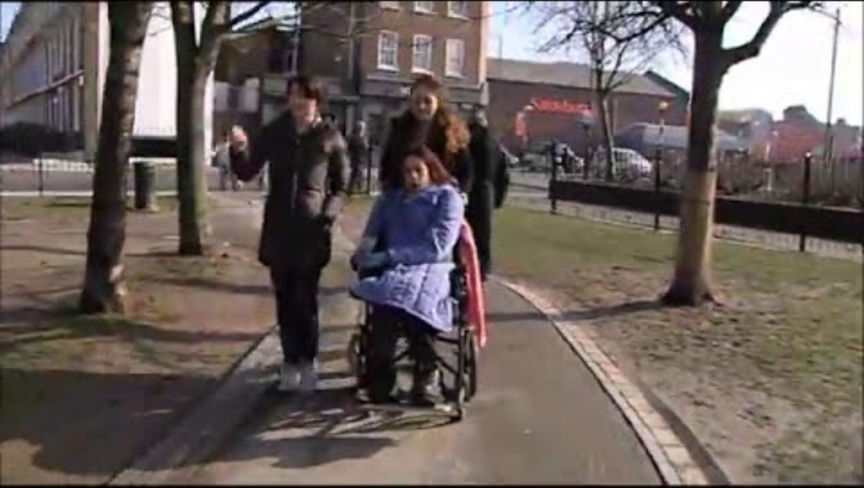


Video about hospital passports
Click on the picture to watch the video
Click here to watch the Mencap - Hospital Passports: Victoria's story on YouTube

Slide 9

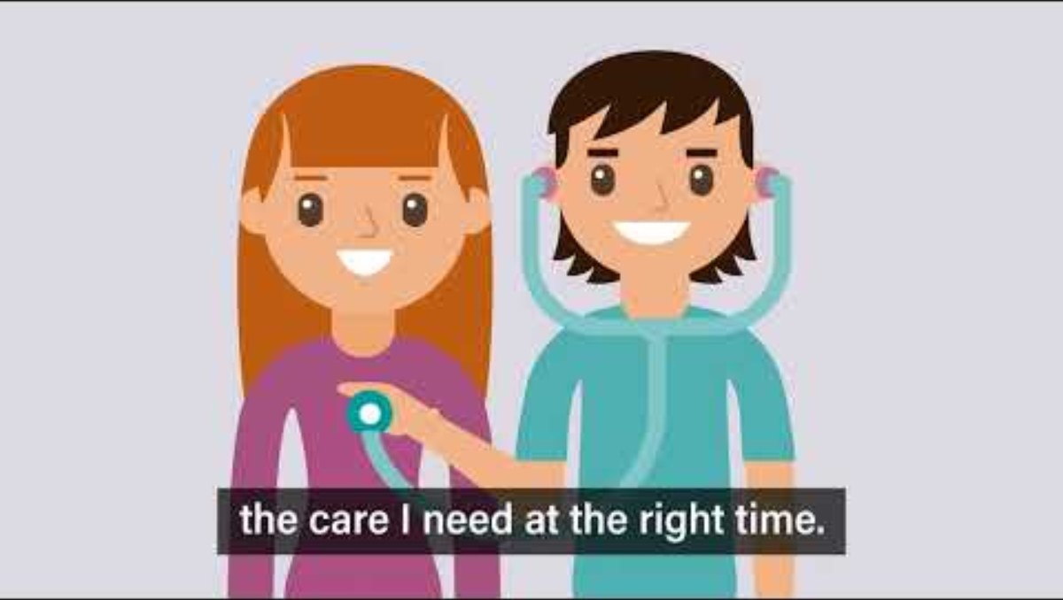
Video about health profiles
Click on the picture to watch the video
Click here to watch the Improvement Cymru - The Health Profile for Adults on YouTube

Slide 10

Resource links
Click here for the Mencap guide on hospital passports (England, Scotland and Northern Ireland)
Click here for the NHS Wales guide on health profiles (Wales)

