Slide 1




Workshop 2 – Development of a National Quality Framework
Dr Shemane Murtagh, Principal Investigator ​
Prof Jonathan Hill, Chief investigator
Dr Roanna Burgess, Clinical academic and lead of the MSK National Audit
Prof Kelvin Jordan, Biostatistician ​
James Bailey, Data Manager ​
Alex Braybrooke, Physiotherapist and Post Graduate Researcher
Dr Sara Winter, Student research lead​

Slide 2
Overview of Workshop 2
Developing the DfI Quality Framework
Identifying Quality Indicators (Prof. Jonathan Hill)
Mapping Indicators to the DfI Dataset (Dr Shemane Murtagh)
Case-Mix Adjustment and Quality Scores (Prof. Jonathan Hill)
Data analyses and Visualisation (Dr Shemane Murtagh)
Notes:
Today’s workshop will walk provide an overview of the approach we are taking to develop the DfI quality framework.
Jonathan will then provide an overview of Alex Braybrook’s PhD work, which focused on identifying a set of clinically meaningful quality indicators for physiotherapy. This work essentially helps us understand how we define quality in physiotherapy care, and which aspects of care are considered clinically important and meaningful to measure.
I’ll then talk through how we have mapped those indicators to the DfI dataset, linking them to the variables within the data dictionary and the surveys that are collected through the platform.
Jonathan will then explain case-mix adjustment, which allows us to account for differences in patient populations and ensure fair comparisons between clinics.
Finally, we’ll look at how the results will be presented back to clinics, including benchmarking, patient feedback, data quality reporting, and how this will all be explored through the DfI dashboard.

Slide 3
Identifying Quality Metrics Prof. Jonathan Hill
Notes:
Jonathan to present on the development of the quality metrics.

Slide 4
2. Mapping quality indicators
Quality Indicator (What defines good care?)
DfI Data Dictionary (What data do we collect?)
DfI Surveys • Baseline patient survey • 3-month patient survey • Clinician follow-up survey
Measurable Quality Metrics (Indicators that can be calculated and reported)
Notes:
Mapping Quality Indicators
Once the set of clinically meaningful quality indicators had been defined, the next step was to determine how these indicators could be measured using the DfI dataset. To do this, we undertook a mapping process, linking each quality indicator to the specific variables collected within the DfI platform.
The data dictionary plays an important role in this process. The data dictionary is essentially a structured description of all the variables collected within the system — outlining what data are collected, how each variable is defined, and where it appears within the surveys.
By linking each quality indicator to the relevant data fields within the data dictionary, we are able to translate the quality indictors into measurable metrics that can then be analysed and reported.
On the next slide, is an overview of what these indicators are and how they are mapped within the Data for Impact dataset.

Slide 5
Theme​ | Quality Indicator | Measurement type ​
Access​ | 1. 1 Satisfaction with waiting time for first appointment​ | PREM​
 | 1. 2 Convenience of appointment scheduling​ | PREM​
 | 1.3 Average waiting time​ (reported only) | Organisational​
Education, Self-Management & Rehabilitation​ | 2.1 % receiving sufficient information about condition/self-care​ | PREM​
 | 2.2 % reporting improved health confidence (MSK-HQ item)​ | PROM (MSK-HQ)​
 | 2.3 % reporting overall good experience of the service​ | PREM​
 | 2.4 New to follow-up ratio​ | Organisational​
Personalised Care​ | 3.1 Shared decision-making​ | PREM​
 | 3.2 % of patients reporting their personal needs were met​ | PREM​
 | 3.3 % of patient reporting that their overall care was well coordinated | PREM
PROMs​ | 4.1 MCID achievement on Pain intensity​ | PROM (PIS)​
 | 4.2 MCID achievement on MSK-HQ​ | PROM (MSK-HQ)​
 | 4.3 MCID achievement on Global change​ | PROM (GROC)​
 | 4.4 % with reduced time off work​ | PROM / Work Outcome​
 | 4.5 % with improved productivity at work​ | PROM / Work Outcome​
 | 4.6 % with chronic high-impact pain ​ | PROM (PEG-3) ​
Population Health​ | 5.1 % reporting improved physical activity levels​ | PROM (MSK-HQ)​
 | 5.2 % receiving lifestyle advice​ | PREM
Notes:
The quality indicators are organised into six themes, which represent key dimensions of high-quality musculoskeletal physiotherapy care.
These themes include Access, Education and Self-Management, Personalised Care, Patient Outcomes, Population Health, and treatment (which we haven’t detailed on this slide).
Within each theme, we have identified a number of specific quality indicators that reflect what good care looks like in practice.
For example, within the Access theme, we are looking at indicators such as patient satisfaction with waiting time for their first appointment, convenience of appointment scheduling, and the average waiting time to be seen.
As you can see in the right-hand column, these indicators are linked to specific data points collected within the patient surveys and organisational data within the platform.
The data for each of these indicators will be analysed at the clinic level, meaning that each clinic will receive a score for each indicator based on the data reported by their patients and services.
In addition to this, the indicators within each theme will be combined to generate an overall theme score.
So, continuing with the Access example, a clinic would receive individual scores for satisfaction with waiting time, convenience of scheduling, and average waiting time. These would then be combined to produce an overall Access score for that clinic.
This allows clinics to see both how they are performing on individual aspects of care, as well as their overall performance within each theme.
These scores will then be presented alongside national benchmarks and visualised through plots and dashboards, helping clinics understand how their service compares and where there may be opportunities for improvement.

Slide 6
Case-mix adjustment Prof. Jonathan Hill
Notes:
Hand over to Jonathan, who will talk about case-mix adjustment. Jonathan will explain what case-mix adjustment is, how it is calculated, and why it is important when analysing and comparing clinic-level data.

Slide 7
Data analyses and Visualisation Dr Shemane Murtagh

Slide 8
Calculating Quality Indicator Scores
Clinics will receive:
A score for each individual quality indicator
An overall score for each quality theme
Scores will be presented in two forms:
Raw score (i.e. Unadjusted score based directly on the reported data)
Case-mix adjusted score (i.e. Score adjusted to account for differences in patient populations)
This allows clinics to understand their performance and compare fairly with other services.
Notes:
Once the indicators have been defined, and once case-mix adjustment has been applied, the next step is to calculate the quality scores for each clinic.
Each clinic will receive a score for each individual quality indicator, as well as an overall score for each quality theme.
These scores will be presented in two ways.
- The first is a raw score, which is the unadjusted result based directly on the data reported by the clinic.
- The second is a case-mix adjusted score, where the results are adjusted to account for differences in patient populations. For example, differences in age, co-morbidities, baseline severity, or previous episodes of pain.
Providing both scores is important because it allows clinics to see their results directly, but also to compare their performance more fairly with other services that may be seeing different types of patients.

Slide 9
Example Clinic – Theme: PROMs
Quality Indicator | Clinic Score (Raw) | Case-mix Adjusted Score | National Average | Stretch benchmark (top 10%)
MCID achieved – Pain intensity | 62% | 58% | 60% | 84%
MCID achieved – MSK-HQ | 55% | 53% | 54% | 61%
MCID achieved – Global change | 68% | 64% | 57% | 70%
Reduced time off work | 41% | 39% | 38% | 43%
Improved productivity at work | 47% | 44% | 45% | 49%
Chronic high-impact pain (PEG-3) | 18% | 16% | 16% | 20%
Overall PROMs Theme Score: Clinic 54% | National 52%
Notes:
This slide shows an example from the PROMs theme to illustrate how the results will be reported.
For each indicator, we calculate the percentage of patients who achieve a specific outcome, such as achieving a clinically meaningful improvement in their symptoms.
In the PROMs theme, the first three indicators relate to MCID — the Minimal Clinically Important Difference.
MCID represents the smallest change in a score that patients perceive as a meaningful improvement in their condition.
For example, in this case, looking at the top three indicators, we are looking at whether patients achieve a clinically meaningful improvement in pain intensity, MSK health using the MSK-HQ, and global health change.
The table shows three values: the clinic raw score, the case-mix adjusted score, the national average, which provides a benchmark for comparison, and the stretch benchmark.
You will also see that the results of this example are colour coded. Where scores fall within the expected range, they are shown in amber, and where they are above the expected range, they are shown in green.
On the far right, we have also included a stretch benchmark, which represents the top 10% of performance across clinics. This helps provide an indication of what high-performing services are achieving.
These indicators are then combined to produce an overall PROMs theme score for the clinic.
Rather than presenting this information only in tables, the results will also be visualised using plots, which allow clinics to quickly see how their performance compares with the wider dataset.
This is where the dashboards come in. On the next slides, I will show two examples of how the data can be visualised — a funnel plot and a caterpillar plot.
These plots help clinics understand how their results compare with other clinics nationally, and whether the variation we see is within the expected range or something that may warrant further investigation.

Slide 10
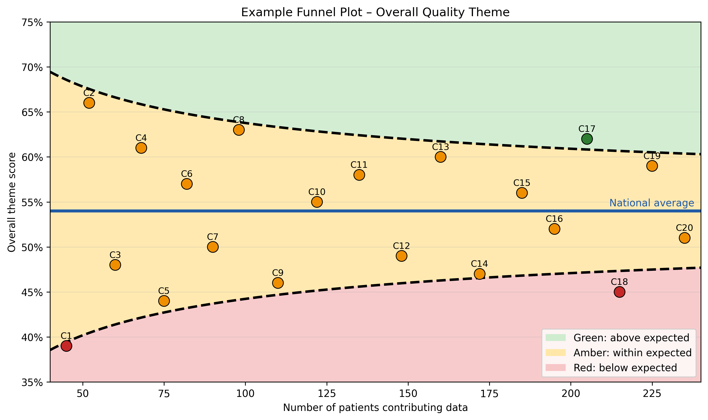
Notes:
This figure shows an example of how results could be visualised for the PROMs theme, which reflects patient outcomes.
Each point represents a clinic. The horizontal axis shows the number of patients contributing outcome data, and the vertical axis shows the overall PROMs theme score, which is based on measures such as improvement in pain, MSK-HQ, global change, and work-related outcomes.
The blue horizontal line represents the national average, while the dashed funnel boundaries show the range of variation we would normally expect between clinics.
Clinics within the amber zone are performing within the expected range, while clinics in green are performing above expected, and clinics in red are performing below the expected range.
Funnel plots normally include 95% and 99% control limits to identify statistical outliers, but for illustration here we’ve used a simplified version of the plot.
For example, Clinic 18 sits below the lower funnel boundary, meaning the proportion of patients achieving improvement in outcomes is lower than would normally be expected given the number of patients contributing data.
In contrast, Clinic 17 sits above the upper boundary, indicating a higher proportion of patients reporting improvement in outcomes compared with the national average.
Most clinics fall within the amber zone, which represents normal variation in patient outcomes across services.
And importantly, the purpose of this approach is not to rank clinics, but to help identify where variation exists and where there may be opportunities for learning and improvement. In practice, clinicians will be able to explore their data in much more detail through the DfI dashboard.
The dashboard will allow clinics to view their results across the different quality themes, see how they compare with the national benchmark, and explore the data using different filters.
For example, clinics will be able to look at outcomes by condition, patient age, comorbidities, or previous pain episodes, helping them better understand the factors that may be influencing their results.
This allows the data to move beyond simple reporting and instead support reflection, learning, and quality improvement within clinics.

Slide 11
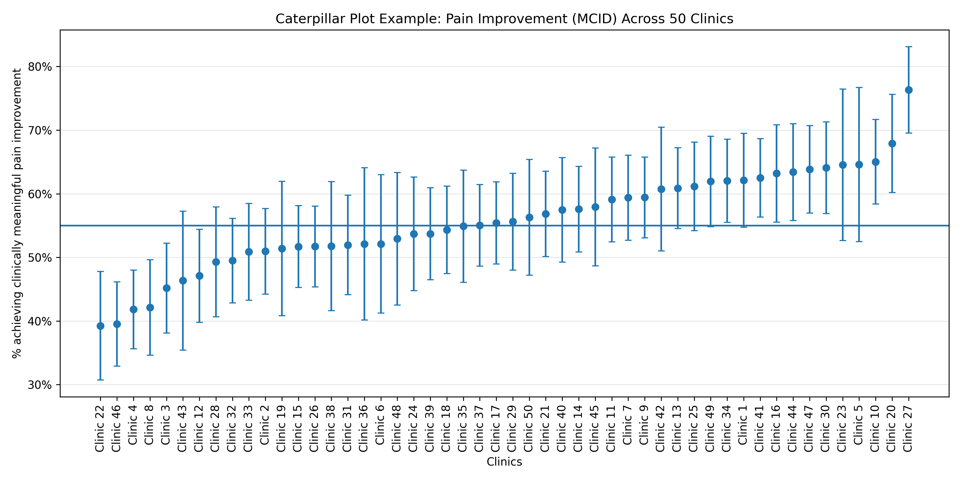
Notes:
So, just another example of a data visualisation.
This figure shows an example of how the results could be presented using a caterpillar plot, looking at pain intensity improvement.
In this case, we are measuring the percentage of patients in each clinic who achieve a minimal clinically important difference, or MCID, in pain.
MCID refers to the smallest improvement in a score that patients perceive as meaningful. So rather than simply looking at whether scores change, we are identifying whether patients experience a clinically meaningful improvement in their pain.
Each point on the plot represents a clinic, and the clinics are ordered from lowest to highest outcome.
-The horizontal line shows the national average, which provides a benchmark for comparison.
-The vertical lines around each point represent the confidence interval. This reflects the level of uncertainty around each clinic’s estimate, which depends partly on the number of patients contributing data.
-So clinics with more patients tend to have narrower intervals, while those with fewer patients have wider intervals.
To illustrate, clinic 34 would be able to see that the % of their patients achieving a clinically meaningful improvement in pain is around 63% and is significantly above the nationally average.
Overall, this type of visualisation allows clinics to quickly see how their outcomes compare with other services, while also recognising the natural variation that occurs within healthcare data.

Slide 12
Data Quality Reporting
Key data quality indicators monitored
Number of patients enrolled
Baseline survey completion rate
Consent to data sharing
Three-month follow-up completion rate
Example clinic
Patients enrolled
= 120
Patients completing initial survey
= 95 (79%)
Patients consenting to data sharing
= 88 (92%)
Patients completing 3-month FU
= 66 (70%)
Notes:
Data Quality Reporting
We also recognise that data quality is critical.
Alongside the quality indicators, we will report metrics relating to data completeness, including:
number of patients seen
number of patients completing the baseline survey
number completing the 3-month follow-up survey
This will provide clinics with insight into the quality and completeness of their data, which is important for interpreting results.
By monitoring these stages we can understand participation, consent, and follow-up rates across clinics, helping ensure that the data used for analysis are robust and meaningful.

Slide 13
Qualitative data: Patient feedback
Example feedback:
Understanding and self-management
“Before physio I was worried I’d done permanent damage to my back. My physio explained what was actually happening and showed me how to manage it myself. I feel much more confident now and I’m back to walking every day.”
Access and early treatment
“I was really relieved to get an appointment quickly. The advice and exercises I was given straight away stopped things getting worse and meant I didn’t need to take time off work.”
Impact of treatment
Three months ago I struggled to get through a full day at work because of the pain. Now I’m back to normal activities and barely think about it.”
Notes:
Alongside the quantitative indicators, we will also be returning anonymised patient feedback to clinics.
This comes from the free-text comments within the three-month patient follow-up survey. These qualitative responses are important because they provide context to the numbers and help services understand patient experience in their own words.

Slide 14

Discussion: Quality assurance kitemarking

Slide 15
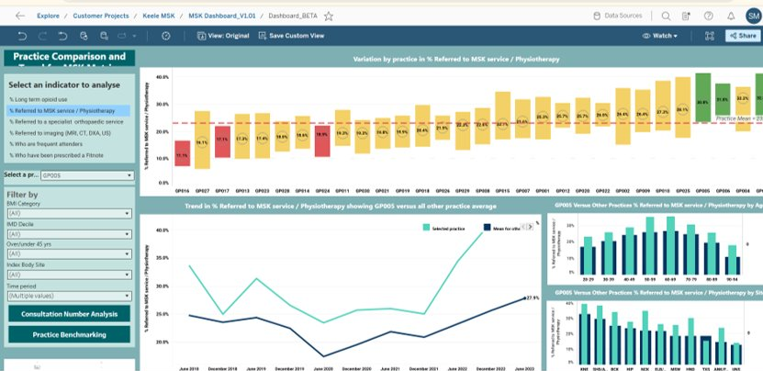
Dashboard and Data Exploration
Notes:
As you can see, the quality indicators and the underlying data will ultimately sit within the DfI dashboard, where clinics will be able to explore and interact with their data.
The dashboard will allow clinics to:
view their quality indicator scores
explore their outcomes in more detail
benchmark their results against national data
analyse their data through a range of clinical filters
These filters will allow clinicians to explore their data in a way that is clinically meaningful.
For example, clinics may wish to look at outcomes by:
condition
age
co-morbidities
previous pain episodes
baseline severity
This allows clinicians to move beyond a single overall score and instead understand how outcomes vary across different patient groups within their service.
So hopefully this gives you an overview of how the quality indicators, the data, and the dashboards will work together to support quality improvement within clinics.
To finish, I’ll briefly update you on where we are with the project and what’s coming next.

Slide 16
Project Updates and Next Steps
Platform updates
3-month patient surveys are now operational
PMS integrations are being finalised
New study
The paediatric feasibility study will begin in the next few weeks
Data and analytics
Data is now being received through the platform, allowing us to move forward with the development of: the DfI Quality Framework in development the interactive dashboards for clinics in development
Next workshop – Friday 17th April (1pm)
Notes:
A quick update on where we are with the project and what’s coming next.
The three-month patient surveys are now operational, which means we are starting to receive the follow-up outcome data that is essential for the quality framework and reporting.
The remaining PMS integrations are currently being finalised, which will make it easier for clinics to enrol patients and submit data directly through their clinical systems.
We will also be launching the paediatric feasibility study in the next few weeks, which will explore how the platform can support data collection for children and young people.
As the data continues to come in, this now allows us to move forward with the development of the quality framework and the interactive dashboards that will return insights back to clinics.
Patient profile view will go live within the next 2 weeks.
The next workshop (workshop 3) is planed for April 17th .

Slide 17
Dr Shemane Murtagh, Senior Research Fellow
Principal Investigator - Data for Impact (DfI) Project
Email: s.murtagh@keele.ac.uk
Please see here for further information: https://www.keele.ac.uk/dataforimpact/

