Slide 1


Workshop 1: Updates and focused feedback
Notes:
Introduction to the DfI Workshop Series
This workshop was the first in a series of four sessions designed to gather structured clinician feedback following the rollout and recent updates to the Data for Impact (DfI) platform.
The session was led by Dr Shemane Murtagh (Project Lead, DfI) and Professor Jonathan Hill. We were also joined by:
Liz Palmer, Research Officer at Physio First
Christian Braybrooke, Process Assured
These workshops are an important part of ensuring the platform continues to evolve in a way that is clinically meaningful and practically workable.
Purpose of the Session
The focus of this session was to gather your feedback on the project, particularly in relation to specific areas of development within the DfI platform.
Your insights are critical in helping us refine the system so that it:
Works effectively within real clinical environments
Minimises burden
Delivers meaningful value back to clinicians
This is an iterative process, and your feedback directly informs the next stage of development.

Slide 2
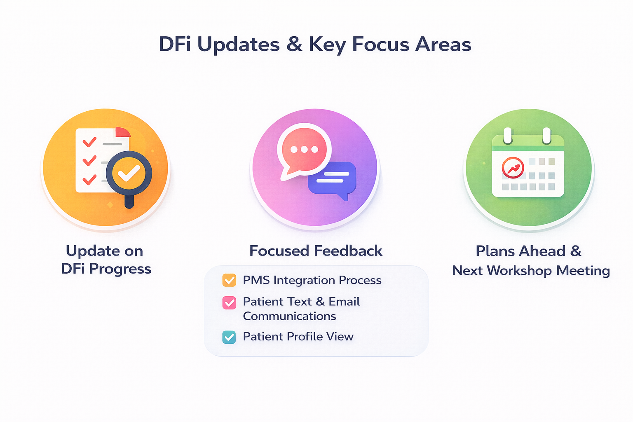
Purpose of workshop
Update on DfI progress
Focused feedback
PMS integration process
Patient profile view
Patient communication
Coming next to DfI & next workshop
Notes:
Session Overview
In this workshop, we covered three main areas:
1. Update on DfI Progress
We provided an overview of the current status of the Data for Impact (DfI) platform, including recent developments and updates following rollout. This included progress on platform functionality, integration work, and ongoing refinement based on early implementation.
2. Focused Feedback
A core aim of the session was to gather structured feedback from clinicians. We discussed specific aspects of the platform where your input is particularly valuable, including usability, workflow integration, data capture, and reporting. Your feedback will directly inform the next phase of development.
3. What’s Coming Next
We outlined the next stages of the project, including planned updates and areas of refinement. We also introduced the structure of the upcoming workshop sessions and what will be covered next.

Slide 3
DfI update
Roll out of the platform
Platform launched for manual enrolment (Nov 2025)
Developed API process for Cliniko & Nookal (Feb 2026)
Two further API integrations coming next week (PPS & TM3)
Data entry
65% patient completion rate
3-month patient surveys being sent (completion rate to be confirmed)
Data and research output
Existing data (n= 120,000): Masters level data use, publication and industry
New dataset
Validated short-form MSK HQ
Notes:
DfI update
1. Platform Implementation
The DfI platform was launched for manual enrolment in November 2025. This allowed clinics to begin using the system immediately while wider integration work continued in parallel.
In February 2026, we successfully developed and implemented API integration processes for Cliniko and Nookal. These integrations allow data to flow more seamlessly from clinic management systems into the DfI platform, reducing duplication and administrative burden.
Two further API integrations (PPS and TM3) are scheduled to go live next week. Expanding integration capability is a key priority, as embedding DfI within existing workflows is central to long-term sustainability and clinician engagement.
2. Data Entry and Patient Engagement
Since rollout:
The current patient completion rate is approximately 65%. This reflects strong early engagement, particularly given that this is a new system and process for many clinics.
Three-month follow-up patient surveys are now being distributed. Completion rates for follow-up surveys are currently being analysed and will be shared once confirmed.
Monitoring both initial and follow-up completion rates is important to understand real-world feasibility and to identify where further refinements may support improved patient engagement.
3. Data and Research Output
Existing Dataset (n = 120,000)
The existing DfI dataset, comprising over 120,000 patient episodes, continues to support:
Master’s level research projects
Peer-reviewed publications
Industry and professional body reporting
This dataset remains a significant national asset and underpins ongoing research and policy engagement.
4. New Dataset
The newly structured dataset, aligned with the updated DfI platform, is now beginning to accumulate data. This dataset will support:
Fairer benchmarking
Improved risk adjustment
Enhanced quality improvement analysis
5. Validated Short-Form MSK-HQ
As part of the platform development work, we have also completed validation of a short-form version of the MSK-HQ. This provides a more streamlined outcome measure while maintaining robust psychometric performance, supporting both clinical feasibility and national comparability.

Slide 4
Focused feedback: PMS integrations
Two options for PMS integrations
Option 1: Generic API
Option 2: Specific (with custom field)
Instructions hosted on Keele DfI webpages
https://www.keele.ac.uk/dataforimpact
Notes:
PMS integration
There are two main ways clinics can integrate their Practice Management System with DfI.
1. The first is the generic API integration. This is the simplest route and will suit many clinics. Once connected, eligible patients are automatically moved from your PMS to the platform. There’s no manual enrolment required to the DfI platform. Surveys are sent automatically before the first appointment and at three months, and the data flows straight into the DfI platform.
2. The second option is the custom field API integration. This gives clinics more control. A custom DfI field is added to your PMS, and clinicians can actively select which patients should be included (which you identify as eligible or not). This can be helpful for clinics running mixed services or wanting tighter control over inclusion.
Both routes remove the need for double data entry and are designed to embed data collection into everyday workflow.
Full setup instructions for each PMS are available on the Keele DfI webpages, with step-by-step guidance and support.

Slide 5
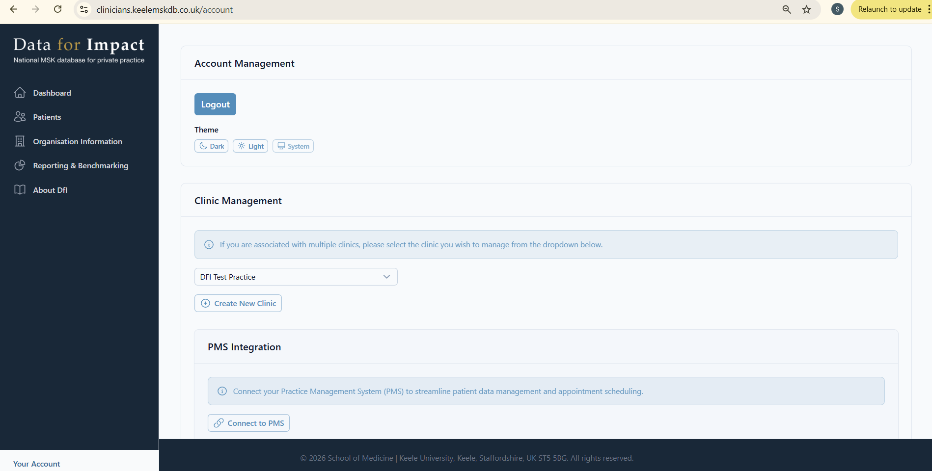
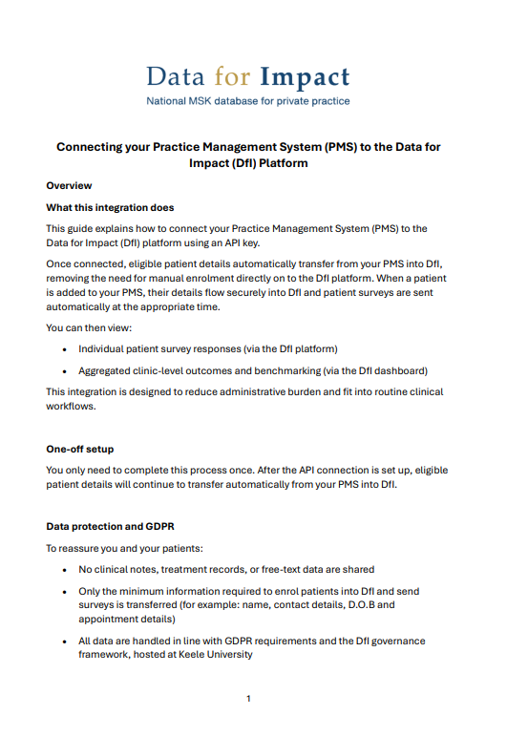
Go to ‘Your account’ and scroll down to PMS integrations
Instructions: www.keele.ac.uk/dataforimpact
Notes:
Connecting to Your Practice Management System (PMS)
This slide shows a screenshot of the ‘Account’ section within the DfI platform.
To enable PMS integration:
1. Navigate to the Account section of the platform.
2. Select “Connect to PMS.”
Follow the step-by-step guidance provided in the integration document available on the Keele DfI webpage: www.keele.ac.uk/dataforimpact
The guidance document outlines the specific steps required for your system and explains how data will securely transfer between your PMS and the DfI platform.
If you experience any difficulties during setup, please contact the DfI team and we will support you through the process.

Slide 6
PMS integration: Feedback and questions
Understanding & readiness
Any questions about how the PMS integration works?
Perceived barriers
Do you foresee any technical challenges?
Are there internal IT or governance approvals needed?
Do you have capacity/time concerns?
System compatibility
Are you using Cliniko, Nookal, PPS, TM3 - or another system?
Are there other PMS providers we should explore?
Notes:
These were the questions provided to guide feedback and questions within the workshop.

Slide 7
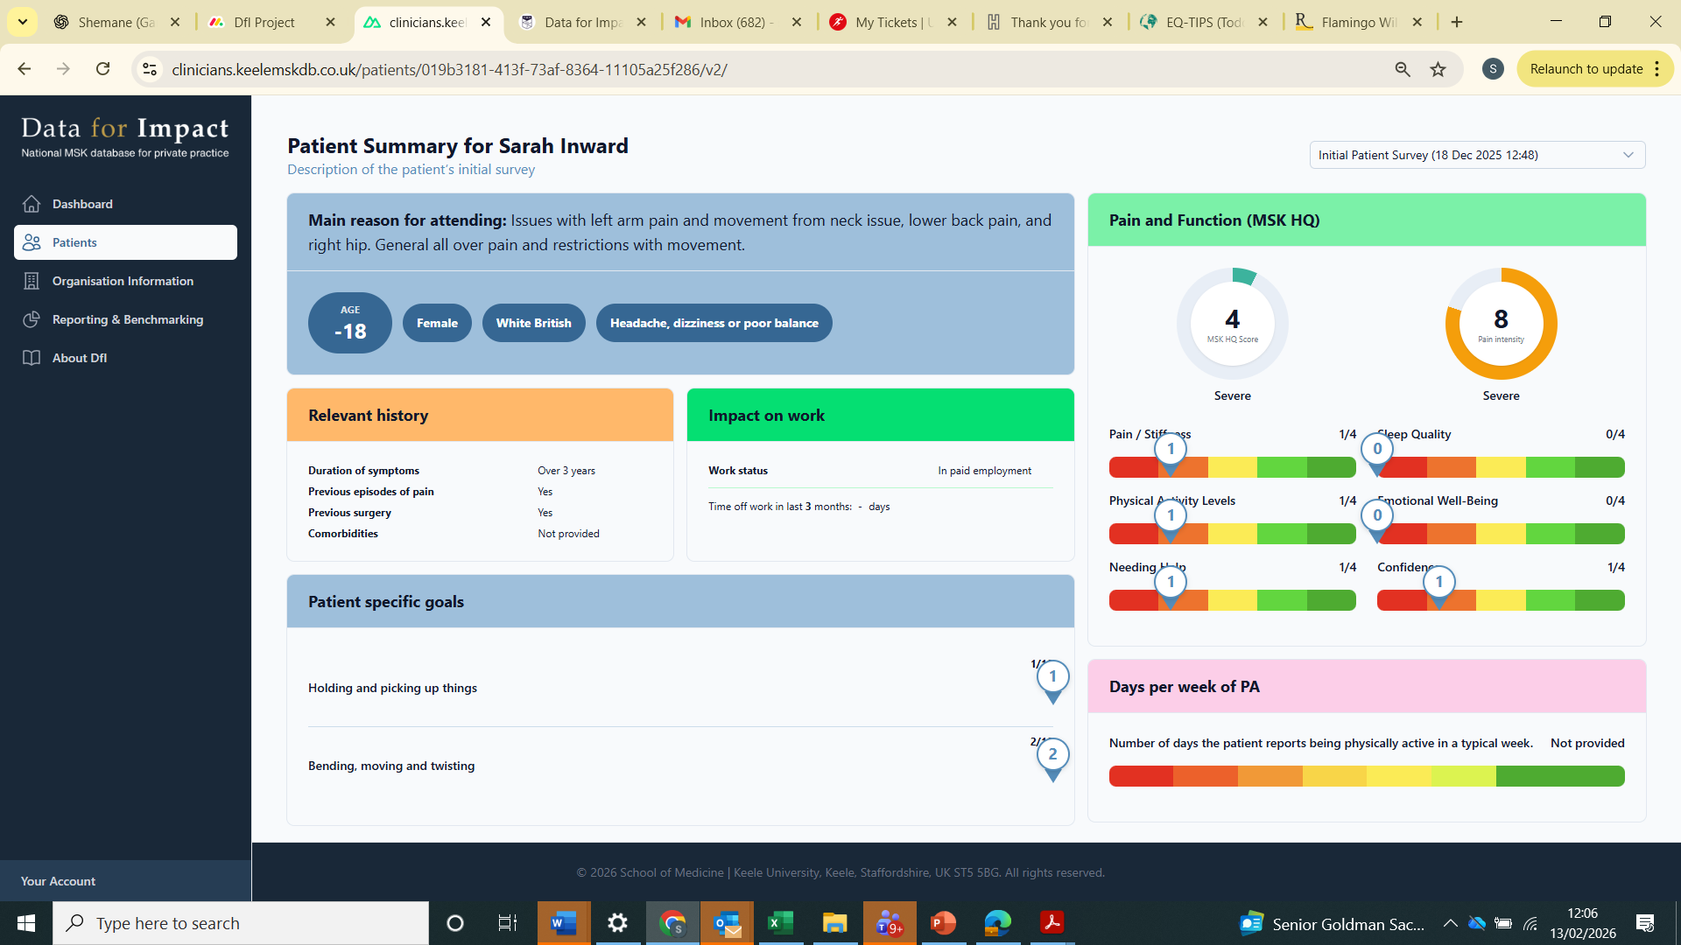
DfI platform: Patient profile view
Initial patient survey results
Visual summary
Meaningful overview of the patient before first appointment
Notes:
The Patient Profile View
This is a visual summary of the initial patient survey. As soon as a patient completes their baseline survey - and before their first appointment - you can view their responses in one clear, structured profile.
It’s designed to save time and give you a quick, meaningful overview of the patient before you see them.
You can immediately see:
Their baseline pain and function
The main areas affecting their daily life
Any wider health considerations
Their goals and expectations
An important part of the platform is that we are providing patient-level data directly back to clinicians in a format that is genuinely usable in practice.
When is this development coming?
We are almost ready to launch this within the platform. Instead of clicking through individual survey responses and reading question by question, you will be able to click on a patient and open a structured Patient Profile View - making interpretation faster and more intuitive.
The next slide provides an example using sample data and get your feedback on how this works in real clinical practice.

Slide 8
Name

Slide 9
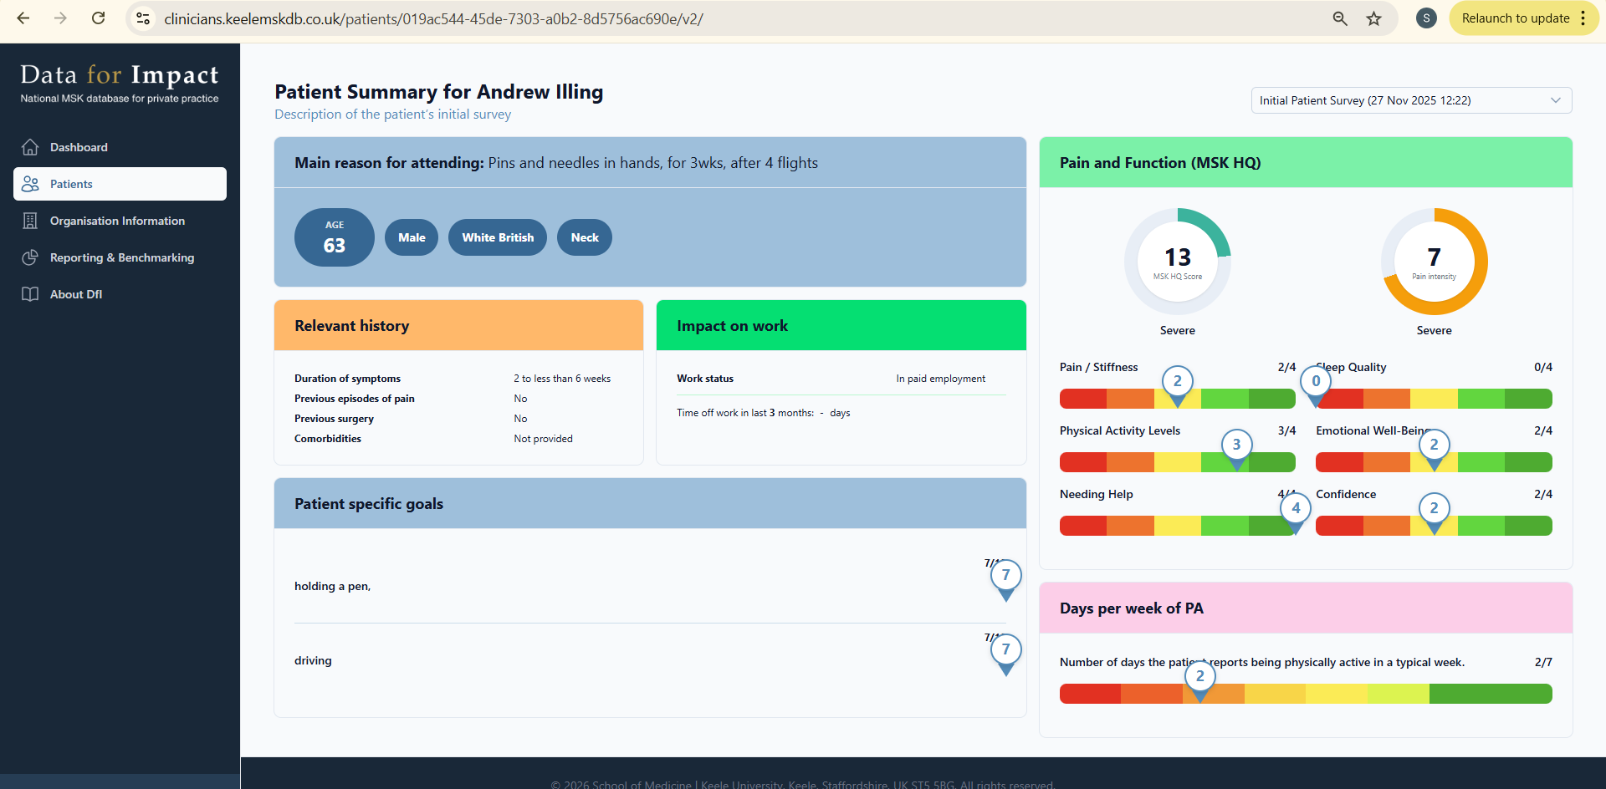
Name

Slide 10
Patient profile view: Feedback and questions
Is the layout clear and easy to interpret?
Are there any wording or labels that feel unclear?
General feedback?
Anything else required that would be helpful at a quick glance?
Notes:
Feeback and question time for the group.

Slide 11
Patient communications
Practical considerations
Does this align with how you currently explain outcome measures to patients?
Are there any foreseeable concerns or questions within your clinic or that your patients might raise?
Clarity & tone
Is the wording clear and easy for patients to understand?
Does the tone feel appropriate for your patient population?
Engagement & compliance
Do you think patients will understand why they’re being asked to complete this?
Is there anything we could adjust to improve completion rates?
Notes:
Patient Communication
We have recently updated the patient text messages and email templates following early feedback from clinics. Before these are rolled out more widely, we would greatly value your input.
Our aim is to ensure that patients:
Clearly understand why they are being asked to complete the survey
Feel confident about how their data is being used
See the questionnaire as part of their care, rather than simply another form to complete
The messaging has been designed to be concise, transparent and supportive of positive patient engagement.
We would particularly welcome your feedback on the following areas:
1. Practical Considerations
Does this reflect how you currently explain outcome measures to patients?
Are there any concerns or questions you anticipate arising within your clinic?
2. Clarity and Tone
Is the wording clear and easy for patients to understand?
Does the tone feel appropriate for your patient population?
3. Engagement and Completion
Do you feel patients will understand why they are being asked to complete this?
Is there anything we could adjust to improve completion rates?
Your feedback is extremely valuable in helping us refine this communication before wider implementation.

Slide 12
Initial patient survey: Text and email
Dear [patient name]
You have an upcoming appointment at [Clinic Name]. Before you attend, we’d be grateful if you could complete a short survey.
Your physiotherapist will use your responses to better understand your condition and support your care at your appointment. With your consent, your anonymised data will also contribute to the Data for Impact (DfI) programme, a national research initiative led by Keele University to improve understanding of musculoskeletal health and physiotherapy outcomes across the UK. Please see here for further information: www.keele.ac.uk/dataforimpact
You will be invited to complete the survey again 3 months after your first appointment so we can understand how your condition has changed over time.
Please click the link below to complete the survey before your appointment: [surveyLink]
Thank you for taking the time to complete the survey.
Hi [Patient name], your appointment at [Clinic name] is booked for 13th February at 1:00pm. Please complete your survey before attending: [surveyLink]. The survey supports your care and contributes to the national Data for Impact programme (Keele University). Any questions, call {Clinic Phone Number}.
Notes:
Updated Initial Patient Message
This screenshot shows the updated initial text message and email that are sent to patients when they are enrolled in the DfI platform.
The wording has been revised following early feedback to:
Clarify why the patient is being asked to complete the questionnaire
Explain how their information will be used
Reassure patients about confidentiality and data security
Position the survey as part of their clinical care
These updates are intended to improve understanding, trust and completion rates.
We welcome any feedback on whether the messaging feels appropriate for your patient population and aligns with how you introduce outcome measures in practice.

Slide 13
3-month follow up survey: Text and email
Dear {PatientFirstName},
It has now been 3 months since your inital appointment at {practiceName}. We would be grateful if you could complete your follow-up survey.
Your physiotherapist will use these responses to understand how your condition has progressed and to understand your experience. With your consent, your anonymised data will also contribute to the Data for Impact (DfI) programme, a national research initiative led by Keele University to improve understanding of musculoskeletal health and physiotherapy outcomes across the UK. Please see here for further information: www.keele.ac.uk/dataforimpact
Please click the link below to complete your follow-up survey: {surveyLink}
Thank you for taking the time to help improve physiotherapy care.
Hi [Patient Name], please complete your 3-month follow-up survey for [Clinic Name]: [surveyLink]. Your responses help us understand your progress and experience and, with consent, contribute to the national Data for Impact programme led by Keele University. Thank you.
Notes:
3-Month Follow-Up Patient Message
This screenshot shows the text message and email that are sent to patients at the 3-month follow-up point.
The wording has been designed to:
Remind patients why they are being contacted
Reinforce that this is part of their physiotherapy care
Clearly explain the purpose of the follow-up questionnaire
Reassure patients about confidentiality and data use
Keep the message concise and easy to understand
We recognise that follow-up engagement can be more challenging than initial completion. For that reason, the tone aims to be supportive rather than demanding, and to emphasise the value of the patient’s response.
We would particularly welcome your feedback on:
Whether the message feels clear and proportionate
Whether it reflects how you would explain follow-up outcomes in your clinic
Any changes that might improve completion rates
Your feedback will help us refine this before wider rollout.

Slide 14
DfI platform: What’s coming next
Launch of the patient profile view (1-2 weeks)
Launch of PMS integration with PPS and TM3 (1-2 weeks)
Paediatric surveys (children and young people aged 0-18 years)
New quality framework (Workshop 2 and 3)
Interactive dashboard (Workshop 2 and 3)
Longer term: Clinic reports (Discussions in Workshop 4)
Notes:
What’s Coming Next
We outlined the next phase of development within the DfI platform, including both short-term releases and longer-term enhancements.
Launching in the Next 1–2 Weeks
Patient Profile View A new patient profile view will be launched, allowing clinicians to see individual patient-level data in a clearer and more structured format. This is designed to improve usability and make outcome data more clinically meaningful at the point of care.
PMS Integration: PPS and TM3 Integration with PPS and TM3 will go live shortly. This builds on the existing Cliniko and Nookal integrations and further supports our aim of reducing duplication and administrative burden.
Expanding Scope
Paediatric Surveys (0–18 years) We are introducing surveys tailored for children and young people aged 0–18 years. This will broaden the reach of the platform and support clinics working with paediatric populations.
Workshops 2 and 3
The next two workshops will focus on:
The new quality framework – outlining how data will support quality improvement and benchmarking.
The interactive dashboard – demonstrating functionality and gathering feedback on usability, interpretation and clinical value.
Your feedback in these sessions will directly shape how these components evolve.
Workshop 4 – Longer-Term Development
In Workshop 4, we will begin discussions around clinic-level reporting. This will explore how aggregated reports may support service evaluation, benchmarking and external reporting where appropriate.

Slide 15
What we’ve heard… fed back to the group.
What we’ll refine
Next steps
Next workshops and focus
Slide 13 – Final Questions

Slide 16
Dr Shemane Murtagh, Senior Research Fellow
Principal Investigator - Data for Impact (DfI) Project
Email: s.murtagh@keele.ac.uk
Please see here for further information: https://www.keele.ac.uk/dataforimpact/
Notes:
These are my contact details. Please email with any questions and feedback.

