Slide 1



Facilitator notes*
Use this slide set in group sessions or one-to-one.
When preparing to run a session please check the slides and activities in advance and download/prepare any additional materials that might be needed.
You may need materials for writing/typing (Slides 5, 7 & 8) and creating pictures (Slide 6).
Click here to access the example social story. Download (and print) it in advance of the session (Slide 9).
Encourage individuals to think about what they might want to include in their story.
Click here for more information about writing a social story.
Click here to visit from easy on the i for more pictures.
*not part of the presentation

Slide 2
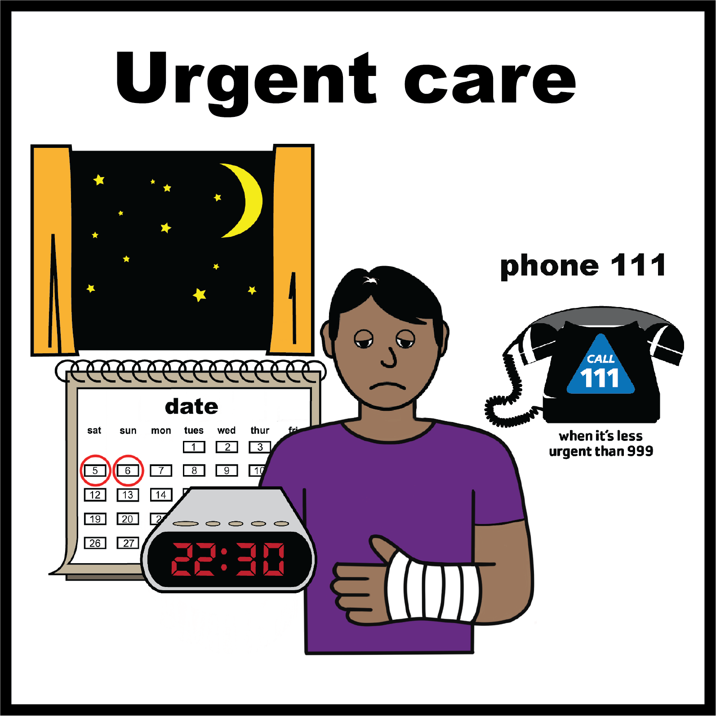
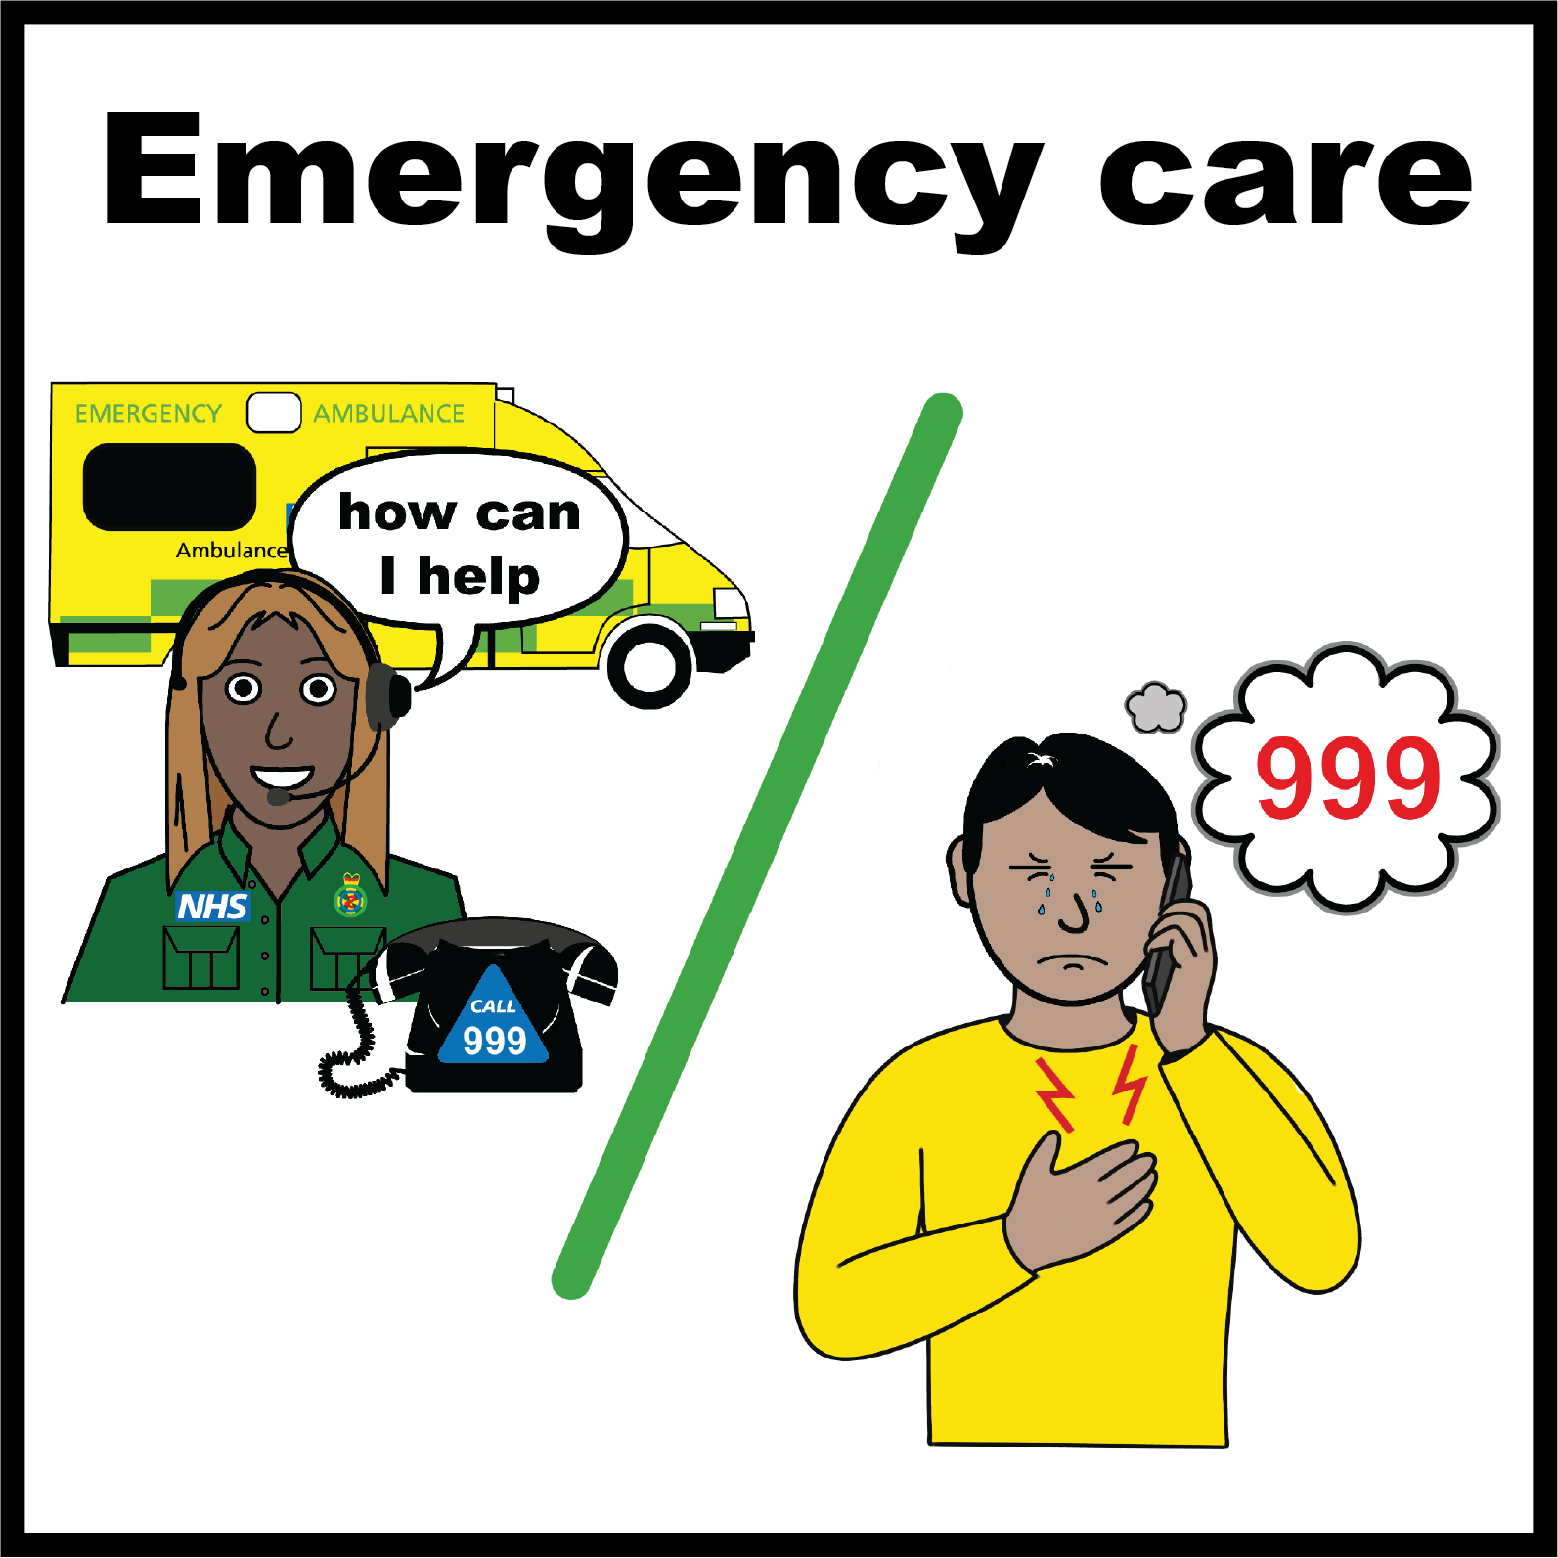

Creating your social story:
Feeling very unwell, or having an accident where I get hurt, at night, or at the weekend.
careled.info
All ‘easy on the i’ images copyright © LYPFT

Slide 3

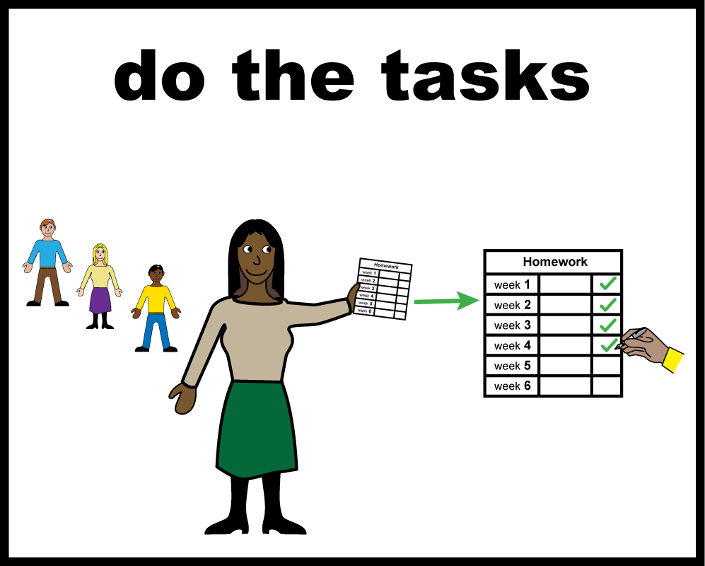
Creating your social story:

Slide 4

Creating your social story:
Think about what you would do if you were unwell or had an accident and got hurt at night or at the weekend.

Slide 5

Creating your social story:
Make a list of the important things you would need to remember.
  This is just for you, so include do’s and don’ts.
  Include things you think will make it easier for you to get help.
  Include things that will upset or scare you and what to do.

Slide 6

Creating your social story:
You can, find pictures, draw your own pictures, or take your own photos to include in your story.
  The pictures might include people you will ask for help, things in your home, places you might need to go, things you might need.

Slide 7

Creating your social story:
Decide what order you would need to do things and write them down in your own words.
  For example:
    I will call…
    I will get my…
    I will ask…
    I will tell them…
    I don’t like…
    I can’t…
    I need…

Slide 8

Creating your social story:
Write your story and add your pictures.
You can ask someone for help if you need it.

Slide 9

Creating your social story:
We have written an example social story about accessing urgent and emergency health care. Click here to access it.
  We have left some spaces to fill in. You can use it as a basis for your story, by adding your own information and pictures.

