Slide 1

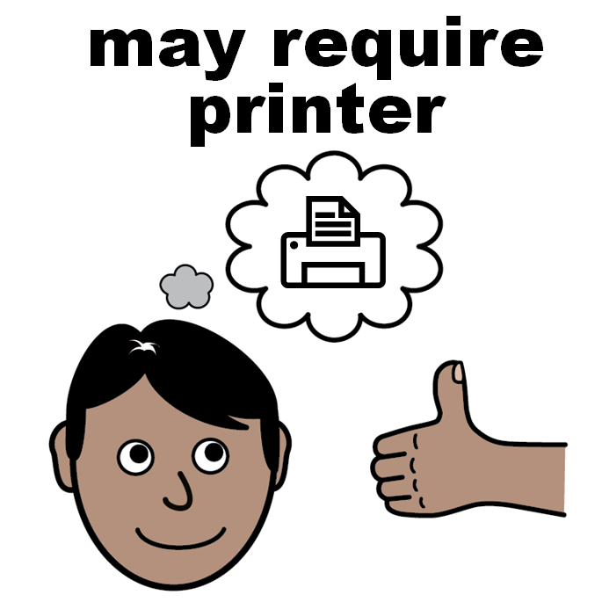
Facilitator notes*
Once the activities are completed there is a certificate available to print.
Download and print certificates in advance of the session (Slide 4).
Encourage individuals to add their name to their certificate. You may need materials for writing (Slide 4).
Their certificate is to keep and show people that they have completed the activities.
Individuals may want to share their learning from the activities with others.
*not part of the presentation

Slide 2
Certificate of completion
careled.info

Slide 3



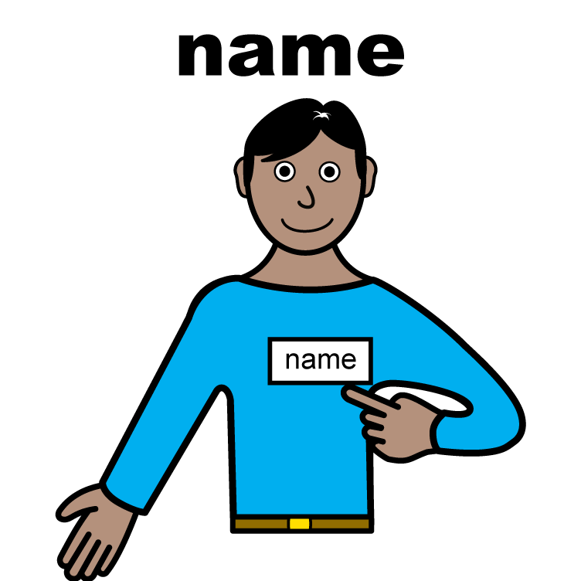

Certificate of completion
Well done for completing the careLeD activities
You can print your certificate
Write your name on your certificate
All ‘easy on the i’ images copyright © LYPFT

Slide 4

Certificate of completion
Proudly presented to:
For learning about how to access urgent and emergency care

